Slide 1
The Startup Ecosystem in the Visegrad Group
Nicole Azimioara
Visiting Fellow

Slide 2
Introduction to Startups
What is a Startup?
Startups are classified as any sort of recently-created business entity in which there is high growth potential

Slide 3
Lifetime Stages of a Startup Company
Pre-Seed
Seed
Early
Expansion
Late
- Identify potential success or failure
- Identify existing challenges, competitors, and feasibility
- This stage marks the official beginning of equity funding for your startup.
- Find insurance policies to mitigate risks
- This stage marks the first round of venture capital financing for your company
- Form ideas for long-term profit
-company has grown beyond potential
-has shown the ability and expectation to hit projected targets
-company expansion and specific jobs are possible
-company is established as profitable
- Can push for further expansion, introduce new products
- Company can also start planning an exit strategy
Notes:
A subsequent stage of a startup functioning on the market is Early Stage. With growing sale, the chance for raising Venture Capital, which is a part of Private Equity (PE) increases. Venture Capital are capital investments realized with an entrepreneur in order to co-finance a startup at the beginning of its development path. The mission of members of associations with VC is not only providing financial aid for startups, but also sharing their knowledge and experience contributing to long-term growth of the company. The enterprise is still burdened with a considerable risk, therefore an investor undertakes cooperation with an enterprise only because of a high return on investment. VCs are a part of a wider concept, i.e. Private Equity. The term PE means capital investments not listed on a stock exchange (SE), where financial means are allocated to private equity firms.
Once a company has those two pieces—an impact-based business model and a committed mindset—it is ready to scale responsibly and sustainably.

Slide 4
Importance of Startups
economic growth of the country= increase in the number of startups
catalysts for economic growth both globally and locally
ensure technological development, extend the range of products and service, and contribute to the promotion of country and region

Slide 5
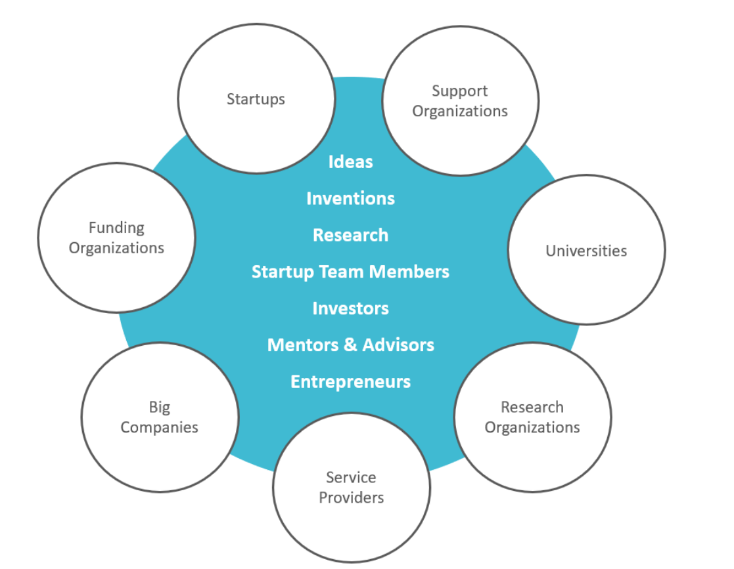
Factors of a Strong Startup Ecosystem
1. Access to talent
2. Access to venture capital
3. Access to incubators and accelerator programs
“The main idea is to grow and share the skills, ideas, and resources within the ecosystem, so it remains conducive to progress and able to rebound from setbacks and disruptions”
Notes:
External factors such as market trends, financial climate, local entrepreneurial culture, and politics can affect the structure and functioning of startup ecosystems. Internal factors include the sum of resources within the ecosystem, such as people, time, money, and skills.

Slide 6
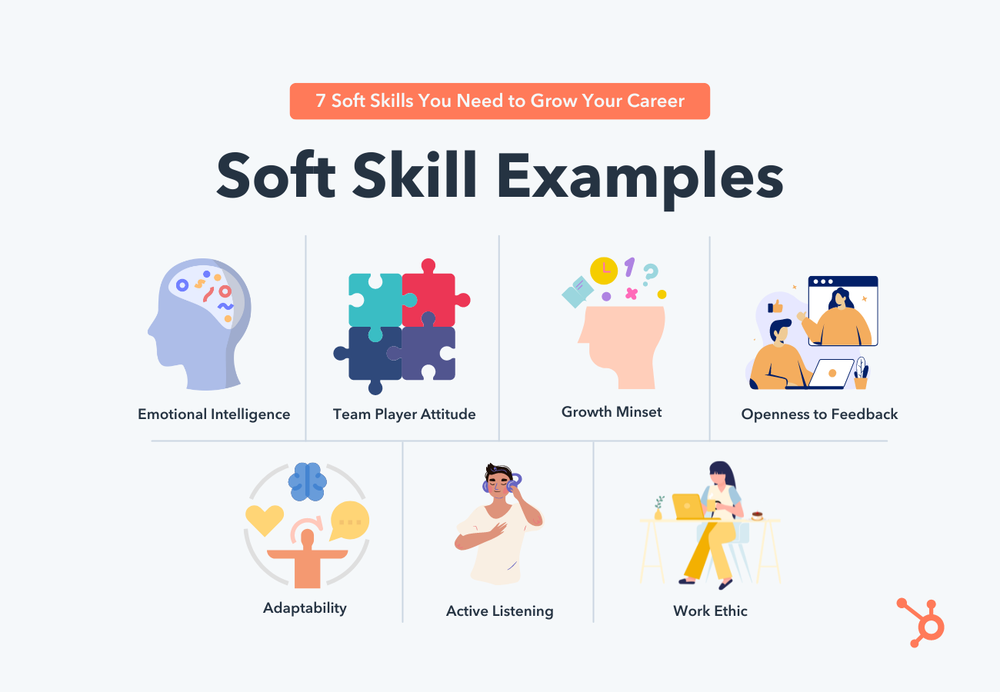
Access to Talent
Founders and Entrepreneurs
Universities and Technical Schools
Soft Skills
Notes:
Low value-added activities- an activity that consumes resources but adds little value to customers. The elimination of a low value-added activity does not change or slightly diminishes customer satisfaction. Examples of low value-added activities include setting up machines, moving product parts, waiting, reworking, inspecting and storing.
High value-added activities- an activity that improves value of products or services to customers. Examples of high value-added activities include designing products, delivering products, processing customer orders, and improving product quality.
“Unicorns”- The term unicorn refers to a privately held startup company with a value of over $1 billion. It is commonly used in the venture capital industry
Soft skills- Soft skills are non-technical skills that relate to how you work. They include how you interact with colleagues, how you solve problems, and how you manage your work.

Slide 7
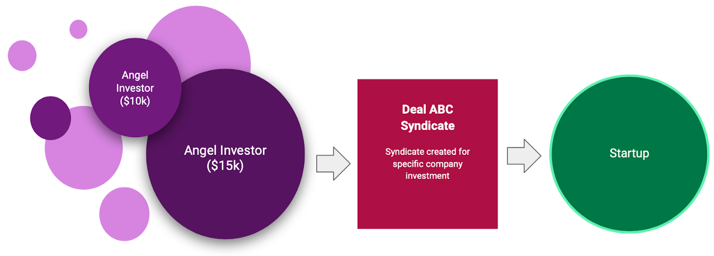
Access to Venture Capital
“Business Angels”
Investing Syndicates
Private Equity vs. Venture Capital
https://medium.com/vcdium/angel-groups-and-syndicates-56abd8fd9424
Notes:
Development of enterprises conditioned by the economic development contributes to emerging of institutions called business angels. Usually these are larger businesses, investing some small part of their capital in new initiatives. Analysis of a startup ecosystem in Poland shows increasing number of business angels, which eagerly finance hatching new ideas
Business Angel Investment Activities- Business angels are private individuals who invest in businesses from a purely business-related perspective. They're often referred to as private or informal investors.
Investment Syndication- A syndicate is a group of investors that pools their capital to invest into deals (SPVs). When you back a syndicate, you'll be invited to deals that you can choose to invest in on a deal-by-deal basis. There is no commitment to invest in deals when you join a syndicate.
Venture Capital- Venture capital (VC) is a form of private equity and a type of financing that investors provide to startup companies and small businesses that are believed to have long-term growth potential. Venture capital generally comes from well-off investors, investment banks, and any other financial institutions.
Seed funding- come from various sources such as family members, friends, banks, or angel investors and is just meant to help a business get started, it is not a way to maintain a business for a long or even medium-term
Revolving Funding- A revolving fund is a fund or account that remains available to finance an organization's continuing operations without any fiscal year limitation, because the organization replenishes the fund by repaying money used from the account. Revolving funds have been used to support both government and non-profit operations.
Private equity is capital invested in a company or other entity that is not publicly listed or traded. Venture capital is funding given to startups or other young businesses that show potential for long-term growth.

Slide 8
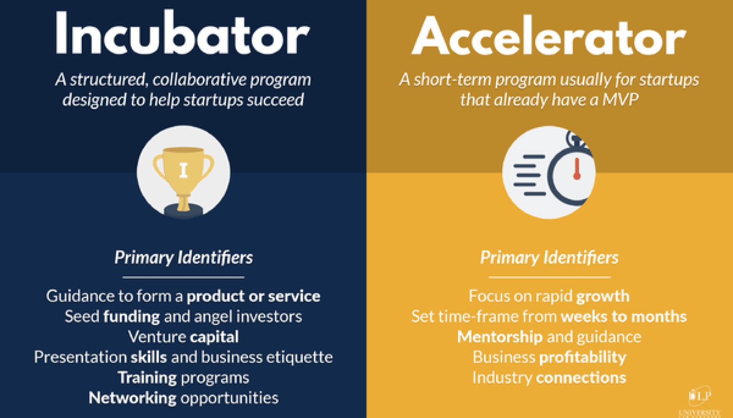
Access to Incubators and Accelerator Programs
Incubators vs. Accelerators
What exactly do they do?
https://www.andcards.com/blog/tips/accelerator-vs-incubator/
Notes:
Incubators- Business incubator is an organization that helps startup companies and individual entrepreneurs to develop their businesses by providing a fullscale range of services starting with management training and office space and ending with venture capital financing
Accelerators- A business accelerator is a program that gives developing companies access to mentorship, investors, and other support that help them become stable, self-sufficient businesses.

Slide 9
Approaching Startups in the Visegrad Group (V4)

Slide 10
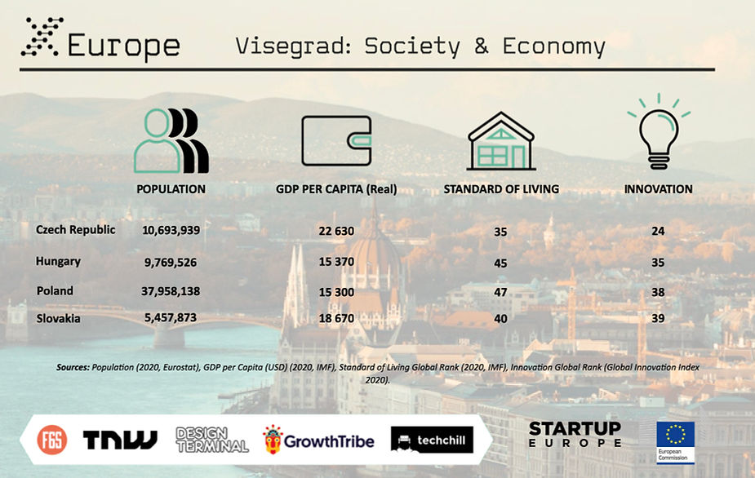
General Information on the V4
If counted as a single nation-state, the Visegrad region is the fifth largest economy in Europe: Czech Republic, Hungary, Poland, and Slovakia together have a population of nearly 64 million people
All of the Visegrad region countries make it in top 50 entrepreneurship global rank
X-Europe

Slide 11
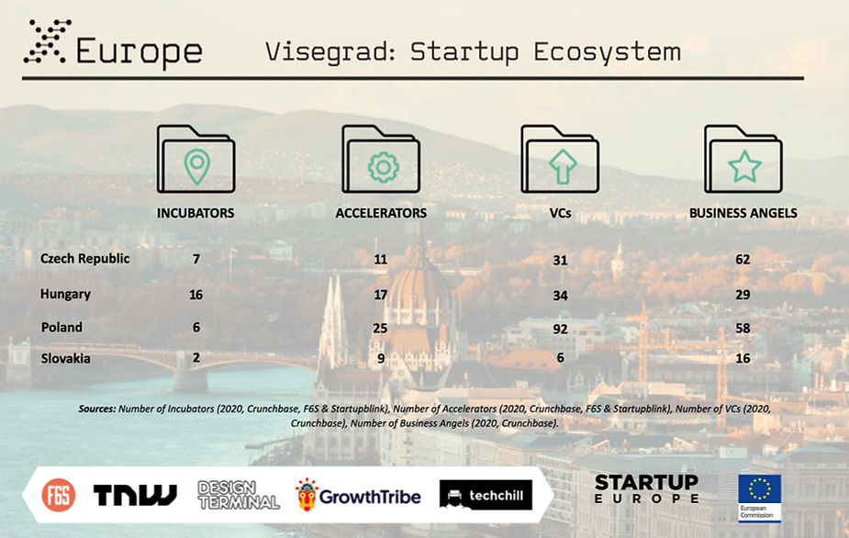
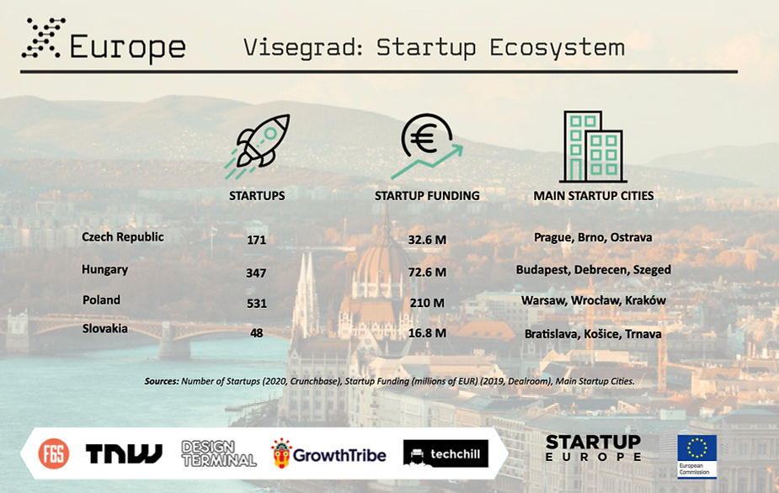
Breakdown of the V4
In conclusion, Visegrad is a very large region with a big market and large talent pool, making it rather easy to attract professionals to startups of various stages. While the region is demonstrating some fear from investors to make sizable investments, the cheap cost of living and human capital still makes it an attractive destination for ambitious founders.

Slide 12
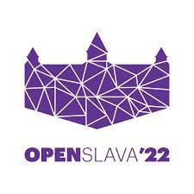
Startup Events in the V4
WebExpo (CZ)- focus on web design, research, and marketing
æternity Universe One(CZ) –focus on AI, Crypto, and hacking
TechSummit (SK) - focus on IT
OpenSlava (SK)-focus on IT
HUSTEFF (HU)- focus on Software
Wolves Summit (PL) – general CEE tech event
Digital Dragons (PL)- focus on digital entertainment
Notes:
WebExpo (CZ) -æternity Universe One(CZ) -
TechSummit (SK) “Techsummit conference is an open platform, which is focusing on the presentation of actual trends and information from the innovation area of IT with emphasis on the dynamics of large and small business environments, improvement of the public environment and international know-how exchange.”
OpenSlava (SK)“OpenSlava 2020 is the 8th edition of a successful conference for a broader IT community in Slovakia and abroad and one of the largest annual international conferences organized by Accenture in CE.”
HUSTEFF (HU) “HUSTEF has grown to be one of the biggest software testing events in Europe, with more than 730 attendees from all over the world attending the 2019 conference. HTB is a nonprofit organization and the local representative affiliate of ISTQB.”
WORLD SCIENCE FORUM (HU) “World Conference on Science is organized by UNESCO and ICSU and held in Budapest in 1999. The World Science Forum is the leading event of global science policy today.”
Wolves Summit (PL) “Wolves Summit is a bi-yearly international networking conference that binds together the world of business and innovation. So far we have pulled out 10 in-person events, 5 100% online conferences and one hybrid event on 5-7 October 2020.”
Digital Dragons (PL) “Digital Dragons is one of Europe's largest business events, addressed to the representatives of the digital entertainment sector.”

Slide 13
Czech Republic

Slide 14
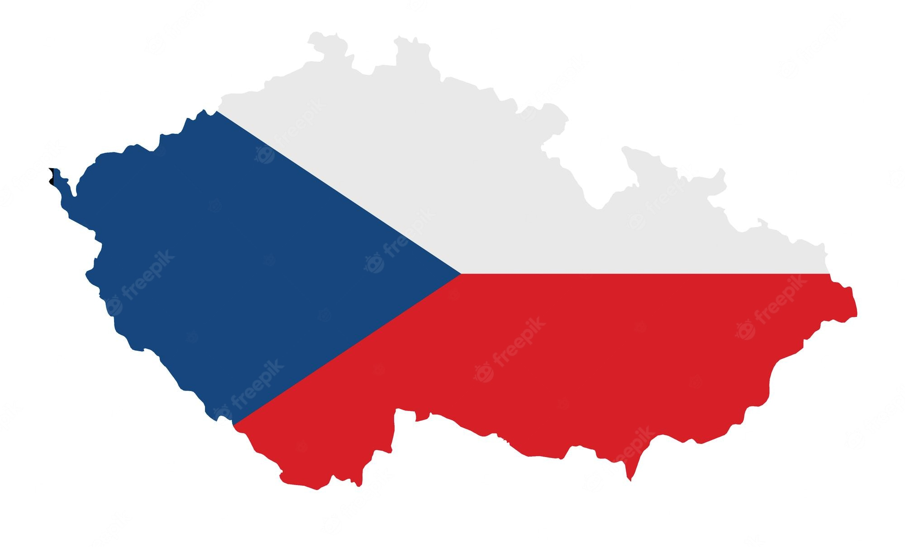
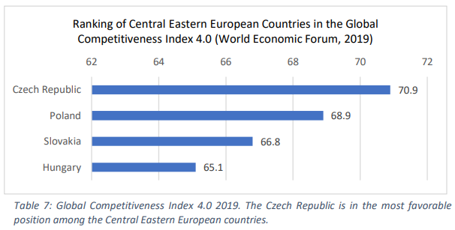
General Information
Startup boom began in 2010
StartupYard, Impact HUB, JIC StartCube and Czech Accelerator
Information and communication: SaaS, web technologies, and mobile software
majority of Czech startups are in the seed phase; financing is limited
Prague and Brno (Svratka Valley)
Notes:
SaaS- Software as a Service
The startup boom in the Czech Republic began after 2010, when new projects supporting startups, e.g. StartupYard, Impact HUB, JIC StartCube or Czech Accelerator appeared. The Czech ecosystem is strong in information and communication. The most common type of products of Czech startups is SaaS, followed by web technologies and mobile software. Concerning the maturity of innovative companies, the majority of Czech startups are in the seed phase, and financing of their projects is limited to their resources. Innovation is not linked only to the capital city of the Czech Republic, even though the majority of startups are based there. Brno, the second-largest city, is becoming known as Svratka Valley as it is built on the river Svratka, and the concentration of startups and big corporations like IBM or Red Hat makes it the perfect environment for innovative entrepreneurs

Slide 15
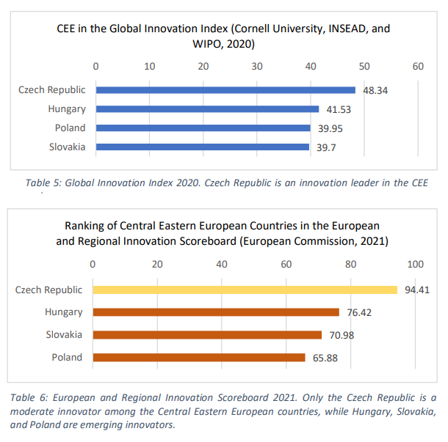

Slide 16
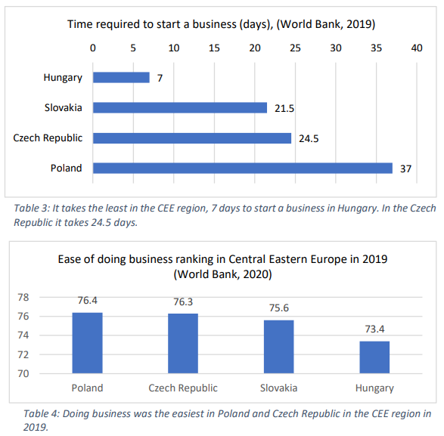
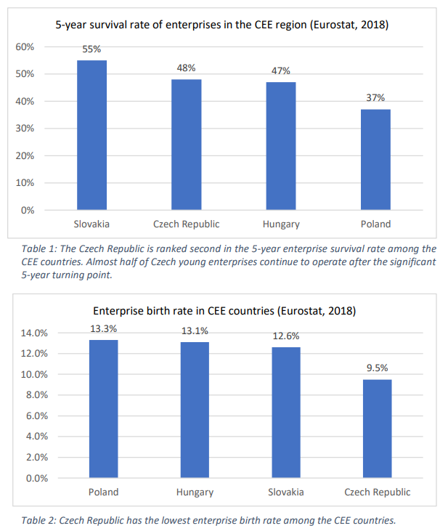

Slide 17
Recent Improvements and Other Strong Areas
OP EIC 2014-2020 - allocation of 4.3 billion, 434 mln (10 %) for financial instruments in total 1,2 billion allocated on energy efficiency.
National Guarantee Programme (NGP) - allocation in the first stage of CZK 900 mln; NGP enabled loans over CZK 5 billion for SMEs during the last six months; with counter-guarantee from EIF-COSME – European Fund of Strategic Investment.
The Innovation Strategy of the Czech Republic 2019-2030
Notes:
The Innovation Strategy of the Czech Republic 2019-2030
OP EIC 2014-2020 - allocation of 4.3 billion, 434 mln (10 %) for financial instruments in total 1,2 billion allocated on energy efficiency (31 mln on pilot financial instruments).
National Guarantee Programme (NGP) - allocation in the first stage of CZK 900 mln; NGP enabled loans over CZK 5 billion for SMEs during the last six months; with counter-guarantee from EIF-COSME – European Fund of Strategic Investment.

Slide 18
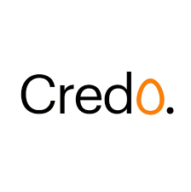
Examples of VC Fund Groups
Credo Ventures
Focus: Seed and Series A Portfolio: 43 Most recent investments: Contentyze (UK), MANTA (US), IP Fabric (CZ)
Reflex Capital
Focus: Seed and Early-Stage Portfolio: 29 Most recent investments: byrd (AT), Leadspicker (CZ), Spaceti (CZ)
Rockaway Capital
Focus: Early and late-stage e-commerce and FinTech startups Portfolio: 32 Most recent investments: Vega Protocol (GI), Solana (US), budgetbakers (CZ)
Notes:
Credo Ventures invests in companies that have high-growth potential and international ambitions. They are entrepreneurs at heart, and have experienced both the rewards and shortcomings associated with entrepreneurship. Their experiences provide a foundation for entrepreneurs that could be used to benefit by partnering with Credo Ventures.

Slide 19
Examples of Good Incubators and Accelerators
StartupYard (CZ)
Focus: Seed-stage deeptech startups Portfolio: 72 Benefits: 40,000 EUR investment and perks in the value of 1M EUR.
Lighthouse Ventures (CZ)
Focus: Early-stage tech startups Portfolio: 20 Benefits: Initial investment up to 200,000 EUR, possible follow-up investment up to 700,000 EUR
OPIFER (CZ)
Focus: SDG-related early-stage startups Portfolio: 5 Benefits: Pre-seed and seed investment between 10,000 EUR and 1M EUR

Slide 20
Examples of Successful Startups
Rohlik.cz
Socialbakers
Kiwi.com
Fireball Inc.
Notes:
Rohlik.cz- online supermarket in the Czech Republic and leader of online grocery shopping in Central Europe, founded by Marek Sacha and Tomáš Čupr (Rohlik.group, 2021). The venture capital fund brought Marek Sacha, past CEO and co-founder of the company, into the project in the early stages. They used no accelerator or incubator programs at Rohlik.cz (M. Sacha, personal communication, June 30, 2021). Since its launch in 2014, it has changed shopping traditions, first in the Czech Republic, and later in the CEE region. The company is based in Olomouc and owning other fulfillment centers in the Czech Republic (Rohlik.cz), Hungary (Kifli.hu), and Austria (Gurkerl.at). VC, Partech, Index Venture, European Bank for Reconstruction and Development (EBRD), Quadrille Capital, R2G, and J&T Bank are the investors in the company. Total funding is €220 million, and Rohlik Group is owned by venture capital and valued at €600 million (Dealroom.co, 2021). In 2021, the Czech online grocery startup raised €100 million and reached unicorn status. 5 The Rohlik model will be launched all over Europe, including Germany, Italy, Spain, and France (Lewin, 2021).
Socialbakers- Socialbakers is a marketing platform taking advantage of machine learning, which helps brands to make better decisions and more innovative investments on social media. Socialbakers was founded by Jan Rezab and Jiri Voves in 2008. The subsidiary, Prague-based company, is owned by venture capital and was acquired by Astute, an American company, in 2020 ("Socialbakers Company - About Us", n.d.). The firm is valued at €200 million with the investments of Earlybird Venture Capital, Index Ventures, Astute, and Draper Esprit. The total funding of the company is €30.9 million (Dealroom.co, 2021). They have over 2,500 clients in 100 different countries, which makes it an industry leader in social media marketing. Based on revenue growth, the company is also mentioned among the 5,000 fastest-growing European private companies (World Bank Group, 2018, p. 41)
Kiwi.com- Kiwi.com is an online search tool for finding cheap hidden flights and exploring new travel destinations. The Brno-based company was founded by Jozef Képesi and Oliver Dlouhý in 2012. In 2019, Kiwi.com was valued at €750 million. Ondrej Tomek, General Atlantic, and Impulse Ventures invested in the company, and the type of ownership is subsidiary, angel, and venture capital (Dealroom.co, 2021). Kiwi.com achieved a turnover of €700 million in 2017 and is among the European top 5 online air ticket sellers (World Bank Group, 2018, p. 41). Deloitte ranked Kiwi.com 5th in the Technology Fast 500 EMEA list6 in 2018 (Deloitte, 2019), which is extraordinary in the Czech Republic.
Fireball Inc.- Fireball Inc. is a mobile gaming platform founded in 2019 by young designer Jan Roose. Before starting the company, he worked for various AI startups and freelance as a digital product designer (J. Roose, personal communication, July 9, 2021). Fireball Inc. aims to make role-playing more entertaining and widely accessible for the market. Angel investors from Central Eastern Europe, such as Jiří Hlavenka, an investor in Kiwi.com, and Oliver Dlouhý, CEO and co-founder of Kiwi.com, invested $350,000 in Fireball between 2019 and 2020 and provided mentoring for Roose. In April 2020, the mobile application became the 5th most-backed mobile game on Kickstarter, a crowdfunding platform, which gave a boost in the early phases of the company. The crowdfunding campaign also proved that there is a product-market fit and demand for the Fireball app. According to Roose, the gaming industry is growing rapidly, at around 10% per year globally (2021).

Slide 21
Challenges
Weak investment environment-lack of a comprehensive national concept for their establishment, development, and financing
insufficient motivation to use academic outputs
a rigid approach of corporations and SMEs to cooperate with startups
lack of soft skills
Weak incubators or accelerators
Innovative domestic small and medium-sized enterprises (SMEs) receive limited support to enhance their technologies and innovation performance
Notes:
The Czech Republic has a weaker investment environment, which does not motivate new projects to be set up and funded. There is partial support for startup projects through the CzechInvest agency in the form of incubation and acceleration programs, but there is a lack of a comprehensive national concept for their establishment, development, and financing. Universities support the development of startups/spin-offs with reluctance as these projects are generally considered to be risky. From entrepreneurial practice, there is insufficient motivation to use academic outputs, while in the Czech Republic there is also a rigid approach of corporations and SMEs to cooperate with startups. For the young Czech innovative companies themselves, their ability to expand abroad is lower because of insufficient internationalization.
One of the main challenges of Czech startups, however, is not the access to financing, but the lack of cooperation between businesses, academia, and research institutes (World Bank Group, 2018, p. 41). In the Global Competitiveness Index 2017-2018, the Czech Republic was ranked 41st globally in university-industry collaboration in research and development (World Economic Forum, 2018, p. 103). Overall, there is a strong correlation between industry and academia – when there is a shortcoming, startups are at risk (World Bank Group, 2018, p. 3)
Entrepreneurial education in the Czech Republic is considered weak compared to Europe. Training and mentoring are provided by different programs, such as CzechStarter, which target technological startups. Additionally, generational change and business transfers support are inadequate for family businesses (OECD, 2016).
Nevertheless, the lack of soft skills is apparent when it comes to market the products. Entrepreneurs in Western Europe or the United States communicate their products and market their prototypes better than those in Central and Eastern Europe. This is one of the reasons why many Czech projects remain local. (Czech management schools are sub-par)
The investment community in the Czech Republic is still in its early stages. The number of investors and the amount invested in companies are small. According to the World Bank, business angel investment activities, typically found in European markets, are limited. There is also a general lack of investment syndication. Prague is the central hub for investments, most activities are concentrated there, and the most frequently supported sector is information, communication, and technology (ICT).
Access to venture capital is limited compared to other countries in the CEE region. Despite the growing number of venture capital funds in the country, there is still a deficit in the initial phase of companies (World Bank Group, 2018, p. 29).
State support for entrepreneurial activities is also low in the Czech Republic. There is no state aid to promote risk finance investments available in other European countries for startup and seed funding (Staszkiewicz & Havlíková, 2016, p. 29).
Startups in the Czech Republic receive different levels of support from intermediaries, such as incubators or accelerators. These intermediaries are responsible for connecting businesses with universities and creating academic spinoffs. They provide networking opportunities, access to investors and funding, and mentoring for early-stage startups (World Bank Group, 2018, p. 3). An ecosystem of innovation hubs and accelerators has been set up, and different programs support entrepreneurs (Staszkiewicz & Havlíková, 2016, p. 33). Startup Yard, UP21, Founder Institute Prague, Czech Accelerator, and ESA Business Incubation Center are some of the Czech Republic's most active accelerators and incubators.
The legal environment in the country also makes it hard for entrepreneurs to start their companies. The current red tape in the country can discourage top talent from starting their companies here, and there is a possibility that talent will go abroad where more opportunities are available (Roose, 2021).
The reason behind the country's lag on a global scale might be the limited public investment in research and development cooperation between academia and the private sector (European Commission, 2020, p. 5).
Czech Republic is among the countries in the EU with the lowest funds raised through venture capital
Venture capital, business angel activity, and revolving funding are finite in the country, making investment-dependent areas (such as startups, SMEs, social entrepreneurship) vulnerable (European Commission, 2019, p. 34)
The primary focus remains on low value-added activities, such as manufacturing. Nevertheless, Czech companies are widely integrated into value chains regionally and globally. Innovative firms with higher value-added products and services require more financial support, improving Czech economic efficiency (European Commission, 2020, p. 5)
Innovative domestic small and medium-sized enterprises (SMEs) receive limited support to enhance their technologies and innovation performance
Domestic firms' productivity falls behind large foreign corporations' dominance. Total factor productivity is steady in the country, similar to Hungary and Slovakia but lagging behind Poland (European Commission, 2019, p. 5). Innovative domestic small and medium-sized enterprises (SMEs) receive limited support to enhance their technologies and innovation performance. Although foreign investment boosts the country's economic growth, support for domestic firms is inadequate. Entrepreneurship support is also generally inadequate in the Czech Republic, which blocks the growth of productivity (European Commission, 2020, p. 5).
Specific research on the success of startups or more individual data is lacking due to a lack of cooperation between academia and business in the country

Slide 22
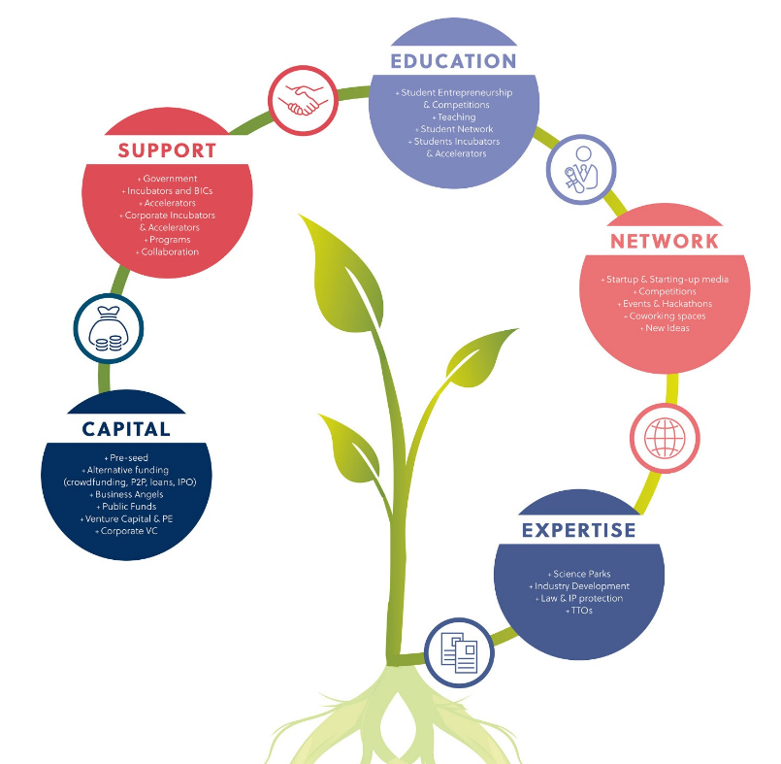
Conclusions
The Czech Republic has an emerging startup ecosystem with several successful companies.
Czech Republic has appealing prospects, but improvements must be made
A more practical emphasis should be placed on entrepreneurial preparation.
Active angel investor communities, along with state support, could give a boost to the startup ecosystem.
Notes:
The Czech Republic has an emerging startup ecosystem with several successful companies.
Regarding the entrepreneurial situation, the Czech Republic has appealing prospects in the Central Eastern European region, but improvements must be made compared to the global scale.
Since education influences future career paths, a more practical emphasis should be placed on entrepreneurial preparation. Due to limited cooperation between the public sector and academia, more partnerships should be launched to attract talent.
Active angel investor communities, along with state support, could give a boost to the startup ecosystem.

Slide 23
Slovak Republic

Slide 24
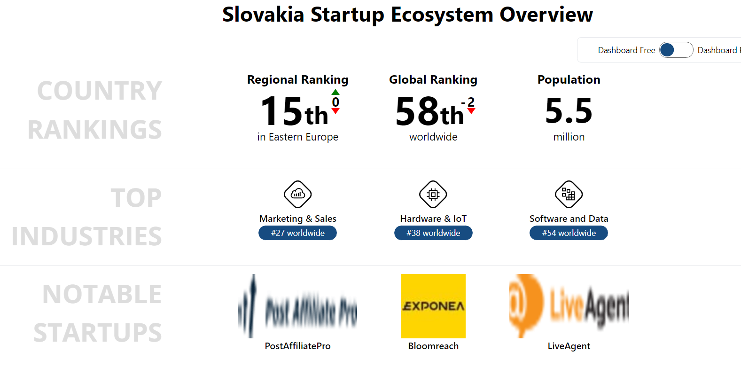
General Information
Regional Leader in innovation, ranked at number 58 globally
The startup scene opened up more broadly about 5-7 years ago
BarCamp, Startup Weekend, Startup Grind and locally-grown Startup Awards competition
Strong and vibrant community of young motivated entrepreneurs meeting in over a dozen of incubators, accelerators and coworking places in Bratislava, Zilina, and Kosice
Notes:
Regional Leader in innovation, ranked at number 58 globally
The startup scene opened up more broadly about 5-7 years ago with the creation of well-established international initiatives like BarCamp, Startup Weekend, Startup Grind and locally-grown Startup Awards competition. Currently, there is a strong and vibrant community of young motivated entrepreneurs meeting in over a dozen of incubators, accelerators and coworking places in Bratislava and other regional centres mainly around major technical universities (Zilina, Kosice). A big advantage is the very manageable size of the country. Everyone knows everyone, and mentors, angel investors and VCs are easily approachable at events or at parties. It is also a great test market for your B2B products since you can easily meet top level executives, corporate partners, VCs or angel investors. Slovakia works on 3 degrees of separation, which is perfect for getting things done.

Slide 25
Examples of VC Fund Groups
Neulogy Ventures
Credo Ventures
Limerock Advisory
ADV Europe/JK Europe investment group
Fund of Innovation and Technology
G4 Investment club
Notes:
ONLY TWO OF THESE ARE SLOVAK
Neulogy Ventures (SK) Focus: Seed and Early-stage Portfolio: 21 Most recent investments: MultiplexDX (US)- Neulogy Ventures is the first Slovakia-based management company to run fully regulated seed and venture capital funds structured along the highest industry standards. Neulogy Ventures build on their thorough knowledge of the local tech scene, deep and wide network of mentors and advisors from Vienna to Silicon Valley, and years of realizing equity investment transactions as both investors and entrepreneurs.
Grants and Subventions- Startups will soon get a boost from state – the startup initiative from Slovak Government is an awesome thing and happened quite recently. This article explains it all but unfortunately it is only in Slovak only, but here you can find the link to a shorter article, which is in English.
Crowd Investing Platforms- In Slovakia we still do not have any crowdfunding platform which would specialize only in this market. Slovaks mainly use the Czech platform Startovac or worldwide known platforms, such as Kickstarter or IndieGoGo.
Angel Investing:
42angels is a platform, which gathers experienced Czech and Slovak entrepreneurs with a passion for start-ups, providing angel/seed stage financing with added value. The page will show you Slovak angel investors like Anton Zajac or Michal Truban.
You should for sure check out the Slovakian business angel network, which will also give you an idea which events you can join to meet investors.
Kenneth Ryan is a managing partner of KPMG in Slovakia and he lifted KPMG up to help local entrepreneurs. Kenneth also writes a lot on mentorships and created a startup Studio, which “in itself is an internal innovation within KPMG in Slovakia. We embraced the idea of a long term investment into startup founders. We refined our product offerings for the needs of startups and aligned our fee structure to startups’ commercial success. Each startup’s needs are unique so we aim at making the support we provide completely tailor-made.”
Venture Capital Investors:
Neulogy Ventures is the first Slovakia-based management company to run fully regulated seed and venture capital funds structured along the highest industry standards. Neulogy Ventures build on their thorough knowledge of the local tech scene, deep and wide network of mentors and advisors from Vienna to Silicon Valley, and years of realizing equity investment transactions as both investors and entrepreneurs.
Speed Invest not only invests capital in world-class talent, but also provides the entrepreneurial know-how, and operational experience that is rare outside of a place like Silicon Valley, but is so essential to building great companies.
Credo Ventures invests in companies that have high-growth potential and international ambitions. They are entrepreneurs at heart, and have experienced both the rewards and shortcomings associated with entrepreneurship. Their experiences provide a foundation for entrepreneurs that could be used to benefit by partnering with Credo Ventures.
Limerock Advisory is a corporate finance and financial advisory services firm. Five partners of the firm provide more than 50 years of combined track record in the areas of business consulting, corporate and investment banking, M&A and private equity. Their goal is to facilitate capital flows for clients and to provide specialised financial expertise related to their business and corporate finance transactions. Limerock Fund Manager focuses on attractive small and medium enterprises and provides growth and expansion capital with no buyout element. They seek companies that want to develop further their successful businesses but we also target new projects in their start-up phase.
ADV Europe is in the portfolio of JK Europe investment group. JK Europe through its companies invest in projects in various innovative and high growth potential areas.
Crowdberry is an innovative way of direct investment of private capital. Crowdberry represents equity-based crowd funding platform portal, whose essential nature is to link groups of qualified investors, namely known and organized in the investor club, with dynamic business ideas. The purpose of the capital increase pre-selected companies exchanged for ownership. They say: “we connect capital with ideas. It is private banking in the world of startups.”
Fund of Innovation and Technology – their mission is to provide a risk capital and support entrepreneurial initiative and thus develop entrepreneurship, employment and the economy towards innovative economy. It was created in response to arising demand for risk capital to support entrepreneurs with ideas and is the result of collaboration Slovak Business Agency (SBA) with investors.
G4 Investment club is a private club of individuals – investors looking for space for further investments. Investment club realizes its investments primarily through entering into equity, mezzanine finance, and project finance loans. Indicative amount allocated to investments for 2013 is 13mln €, with individual investment on the order of 100.000 Euros to 2mln Euros.

Slide 26
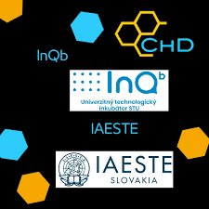
Examples of Incubators and Accelerators
Uplift- Accelerator
RubixLab- Accelerator
INQB (University Technological Incubator)
CEED Tech- EU accelerator program
Notes:
Uplift (SK) Focus: Urban innovation and blockchain startups Portfolio: 2 Benefits: 200,000 EUR investment and potential 10,000 EUR cash prize. Launcher (SK) Focus: Seed and early-stage startups Portfolio: 10 Most recent investments: Angel round and seed-round funding
RubixLab offers seed founding up to 150.000 EUR, innovative working space in an English working environment, talent recruitment and supporting services (HR, Legal, and BD), access to advisors as well as to VCs for further potential founding. RubixLab vision is to become the most sought after business incubator in Central & Eastern Europe until 2019. Thanks to the strategic location that Bratislava has we want to bridge eastern opportunities with the western startup ecosystem and bring them into the international market.
INQB (University Technological Incubator) – the workplace of the Slovakian Technical University in Bratislava, which helps emerging entrepreneurs in the early stages of company development. It focuses on the promotion of technical / technology-oriented innovative ideas. Its aim is to tie science, research and innovation practice. You can get discounted rental of office space and a number of additional services, such as various programs, events, consulting services and so on.
Accelerators:
Booster by The Spot has celebrated its first year of a unique project. 6 business ideas have undergone a 4-month acceleration program and presented themselves in front of various investors on a very special day. These startups now have all the prerequisites to successfully enter the market. Focuses on the consolidation of a product idea.
Flemio – Flemio is a startup & business accelerator focused mainly on IT startup ideas. Flemio can deliver high-end outcomes, its team and partners have many years’ of experience in international corporate business.
CEED Tech is a consortium of five startup accelerators, operating in Central and Eastern Europe. Since 2011, they have launched 94 technology companies, and helped to raise over 10mln Euro in seed and venture capital.
LAUNCHER is a startup studio focused on seed and early stage investments and startups in Central Europe. They build startups and turn them into real companies. They also invest in fast growing companies with international ambitions, skilled people and a scalable & sustainable business concept. To experienced people who have already proven some degree of competence and skills they offer an opportunity to run an independent project or join an existing one.

Slide 27
Examples of Successful Startups
Staffino
UAVONIC
Voltia
CropTech
SEAK
GA Drilling
Mentegram
Notes:
Staffino is an online tool that allows businesses and managers to collect, analyze and respond to customer feedback on specific staff members. The Staffino team is led by Tomas Rosputinsky, an entrepreneur and founder of several businesses, including a crossline advertising Agency This is Locco. Staffino is the 2014 winner of StartupAwards.SK in the Digital category.
AeroMobil is an exceptional vehicle. It‘s a real flying car, with all that a car and an aeroplane have to offer. Because of its true flexibility, you have a choice: road or air. The choice is ultimately up to you, but, whether you choose to be aerial or earthbound, AeroMobil will always turn heads.
Create 3D models right in your browser and have everything saved in the cloud. Accessible from anywhere. Switch between your low-poly model and a smooth-surface model while editing your object. 3D modeling made easy and fun. Export your models to standard 3D files, print them or continue your work in a compatible software.
UAVONIC ranks among the most competitive industrial UAV service providers in Europe. Our drones are equipped with the most technologically advanced sensors available in order to gather data of the highest quality. We then process this information to deliver complete, customized solutions to our clients from different industrial sectors.
Membery is a complex software solution for various types of organisations supporting the management, processes and communication with members. Core functionalites Membership Management Extensive Evidence Processes & Workflows Payments, Fees & Finance Events & Calendar Mass & Target Messaging Website with Custom Design Data Storage (photos, videos, docs) & Sharing Advance Permissions Management & Security.
Voltia aims to accelerate the transition towards clean and sustainable urban logistics by making it easier than ever before for transportation companies to switch to electric. Voltia brings an innovative Electric-Vehicle-as-a-Service approach to professional transportation, involving zero emission light commercial vehicles, charging infrastructure, electric energy, fleet management IT system and advanced customer support as complete service with mobility.
CropTech pioneers home food-growing using hydroponic technology, a method of growing plants by using mineral nutrient water solutions without any soil. The company is developing a fully autonomous, highly scalable and cloud-based hydroponics system for homes and small to medium sized enterprise growers. The stellar team led by Martin Pala raised EUR 250,000 from Neulogy Ventures.
SEAK is a provider of intelligent LED lighting solutions using unique technology of lighting control based on powerline communication. Being able to save up to 40% of energy, this solution is convenient for large industrial and commercial sites, currently serving clients such as TESCO, Volkswagen, RTR ENERGÍA and Venture Lighting.
GreenWay operates the most comprehensive network of electric vehicle charging stations in Slovakia. Our network enables users to enjoy the use of their electric vehicles comfortably throughout Slovakia and abroad. GreenWay fast charging stands are conveniently located near the motorway and highway exits and roads in Slovakia.
GA Drilling is a high-tech company developing and commercializing a groundbreaking technology platform PLASMABIT. Our technology enables massive time and cost savings compared to relevant existing drilling technologies and opens up vast new possibilities in oil & gas, geothermal energy, mining and tunneling.
Ecocapsule is a self-sustainable smart house powered solely bysolar and wind energy. It allows you to live off-the-grid, with the luxury of a hotel room. Ecocapsule is your design way to independent housing. It can serve as a cottage, pop-up hotel or even as a charging station for electric cars.
Mentegram is a professional platform that allows therapists to collect daily mood and behaviour data on their clients, and use this information to deliver more effective treatment. The company was founded by Igor Holas, PhD candidate in psychology at the University of Texas and Milan Steskal, serial entrepreneur with vast experience in digital media.
MultiplexDX is a biotech diagnostics company developing accurate, specific, quantifiable and affordable diagnostic tests, which aim to provide effective and successful treatment of cancer. MultiplexDX is at the forefront of R&D in this area, developing a new visualization technology combining approaches from both molecular biology and histopathological methods.
Diagnose.me is a platform for medical diagnosis connecting patients with elite medical specialists from around the world. The platform works as a marketplace for second medical opinion where patients can choose from any number of top medical specialists based on their expertise, experience, report delivery time and price. Global telemedicine market represents a large opportunity.

Slide 28
Challenges
Starting a Business
Dealing with Construction Permits
Getting Electricity
Registering Property
Getting Credit and Protecting Investors
Paying Taxes
Trading Across Borders
Enforcing Contracts
Resolving Insolvency
Culture
Notes:
Starting a Business When establishing a corporate entity, companies should first check the uniqueness of the company name, before notarising articles of association and obtaining trade licenses, income tax registration and health insurance at the One Stop Shop. A bank account must also be opened and registration with the District Court and for worker insurance needs to be completed. Dealing with Construction Permits The Municipal Authority deals with the lion’s share of procedures when obtaining construction permits. Once the relevant inspections have been completed the building must be registered with the Real Estate Registry. The entire process takes an average of 286 days to complete, although the cost of completing the process is very cheap. Getting Electricity ZSE Distribucia is responsible for connecting new businesses to the grid, and will also conduct most of the works on the property, although an electrical contractor can be sought for certain aspects. It takes 158 days in total to complete on average. Registering Property Registering property is a very streamlined task, taking just over two weeks to complete. Extracts from the commercial register are to be obtained by each party before registration of the transfer can be completed. Getting Credit and Protecting Investors Slovakia has a transparent business environment, which means getting credit is a relatively easy task. Investor protection, however, is an area which requires substantial improvement. The World Bank and IFC rank Slovakia in 117th place in the world for protecting investors. Paying Taxes There are 20 corporate tax payments to make each year which take more than 200 hours of business time to arrange. VAT is the most burdensome aspect of the corporate tax regime, with 12 payments to make per year taking an average of 103 hours to process. Trading Across Borders Trading across borders is both a costly and time-consuming endeavour in Slovakia, taking more than two weeks to both import and export. It costs upwards of $1,500 per container to trade both ways, which is far higher than the OECD average of US$1,028. Enforcing Contracts There are 32 procedures to navigate when enforcing contracts which takes around 545 days to complete. Resolving Insolvency Resolving insolvency takes a massive four years to process, with a lower recovery rate than the OECD norm of 70 cents on the dollar. The cost of completing the procedure is also twice as high as the OECD average. Culture Although westernisation is increasingly influencing Slovak business culture, there are still many traditional values which are upheld in the corporate realm. There is a considerable distance between managers and subordinates, and employees are not accustomed to openly expressing their ideas and opinions to those of higher rank. When it comes to key business decisions, negotiations will take place within a closed circle of professionals, and building relations with the right people is crucial.

Slide 29
Hungary

Slide 30
General Information
Hungary's Innovation Act, adopted in 2005
Startup and technology ecosystem is rapidly growing
Growing number of tech companies securing funding from world-class investors or getting acquired by well-known players
Some of the most successful companies raise money and open headquarters in the US, but they keep most of their R&D activities and tech teams in Hungary.
Great STEM talent pool of Hungary.
Notes:
Hungary's Innovation Act, adopted in 2005
The Hungarian startup and technology ecosystem is rapidly growing. There are many matured tech companies, probably the most well-known Hungary-born scale-ups are Prezi, Ustream, and LogMeIn, but there are many more. There is also a growing number of tech companies securing funding from world-class investors or getting acquired by well-known players. Some of the most successful companies raise money and open headquarters in the US, but they keep most of their R&D activities and tech teams in Hungary. In recent years some of the fastest-growing international tech companies such as Cloudera, Tansferwise or Blackrock opened large development offices in Hungary to utilize the great STEM talent pool of Hungary.

Slide 31
Recent Improvements and Other Strong Areas
Design Terminal - government-backed agency incubating startups
The INPUT program- focusing on boosting second-tier cities
NKFIH- the National Research Development and Innovation Office
The ICT Association has an increasing focus on startups besides being an interest representation organization for the whole ICT industry
Growing governmental involvement.
Hiventures, a government-backed VC firm
Notes:
The Hungarian startup and technology ecosystem is rapidly growing. There are many matured tech companies, probably the most well-known Hungary-born scale-ups are Prezi, Ustream, and LogMeIn, but there are many more. There is also a growing number of tech companies securing funding from world-class investors or getting acquired by well-known players. Some of the most successful companies raise money and open headquarters in the US, but they keep most of their R&D activities and tech teams in Hungary. In recent years some of the fastest-growing international tech companies such as Cloudera, Tansferwise or Blackrock opened large development offices in Hungary to utilize the great STEM talent pool of Hungary.
Design Terminal is a government-backed agency incubating startups and supporting the local scene. The INPUT program is mainly focusing on boosting second-tier cities with its educational programs and mentor networks. NKFIH, the National Research Development and Innovation Office, has recently launched multiple initiatives supporting startups. The ICT Association has an increasing focus on startups besides being an interest representation organization for the whole ICT industry, with some of its key projects (Millenaris Startup Campus, Smart Conference, Open Innovation projects), is one of the most active players the startup ecosystem.
One of the major trends influencing the local startup scene is the growing governmental involvement. During recent years, the role of the government in supportive activities has been increasing rapidly. Hiventures, a government-backed VC firm, was launched 2 years ago. They funded almost 250 startups since then and invested more than 55 million euros. By doing so, they became the most dominant player in the local VC scene. Apart from Hiventures, there are almost a dozen of government-backed incubators (GINOP) supporting startups professionally and with pre-seed funding. New JEREMIE funds are also about to start their operations

Slide 32
Examples of VC Fund Groups
Hiventures
Focus: Early and Late-Stage Portfolio: 203 Most recent investments: Borindex (HU), Oriana International (HU), Timeless Design (Hu)
OXO Labs
Focus: Angel and Seed Portfolio: 16 Most recent investments: Bitninja.io (UK), Omnicoach (HU), Agroninja (HU)
PortfoLion
Focus: Early and Late-Stage Portfolio: 26 Most recent investments: Novakid (US), edrone (PL), Yieldigo (CZ)

Slide 33
Examples of Good Incubators and Accelerators
MKB Fintechlab
Focus: Early-stage FinTech startups in CEE Portfolio: 15 Benefits: Up to 150,000 EUR investment, plus additional funds from partners.
Sup VC
Focus: Pre-Seed, Seed Portfolio: 19 Benefits: Mentorship, Brand & PR, office space, investor matchmaking
Corporate accelerators (MKB, OTP, K&H, MVM, NN)

Slide 34
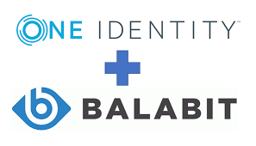
Examples of Successful Startups from Hungary
Prezi
Ustream
LogMeIn/GoTo
Balabit/OneIdentity
Notes:
Prezi- is a Hungarian video and visual communications software company founded in 2009 in Hungary, with offices in San Francisco, Budapest and Riga as of 2020. According to Prezi, in 2021, the software company has more than 100 million users worldwide who have created approximately 400 million presentations. In 2019, they launched Prezi Video, a tool that allows for virtual presentations within the video screen of a live or recorded video. The word "Prezi" is the short form of "presentation" in Hungarian. As of January 2022, the company had around 300 employees in 13 countries
UStream- (purchased by IBM in 2016) provides cloud-based video streaming to enterprises and broadcasters for everything from corporate keynotes to live music concerts. The company streams live and on-demand video to about 80 million viewers per month for customers such as NASA, Samsung, Facebook, Nike and The Discovery Channel.
LogMeIn/GoTo- is a flexible-work provider of software as a service (SaaS) and cloud-based remote work tools for collaboration and IT management, with products including GoTo Connect, GoTo Resolve, Rescue, Central, and more, built for small and midsized business IT departments but powerful enough for the enterprise. The company was founded in 2003 and based in Boston, Massachusetts, and rebranded from LogMeIn to GoTo on February 2, 2022. The rebrand to GoTo comes with a simplified product portfolio to a single application and two flagship products: the IT management & support product, GoTo Resolve, and a new experience for the unified-communications-as-a-service (UCaaS) product, GoTo Connect. These products are unified by a single application, administrative system, and converging user experience
Balabit/OneIdentity- was a Hungarian security firm specializing in the development of IT security systems and related services that help businesses reduce the risk of data breaches associated with privileged accounts. Balabit claims to have more than 1,000,000 corporate users worldwide. The company operates globally with offices across the United States and Europe, together with network of reseller partners. In January 2018, Balabit was acquired by One Identity, a U.S.-based provider of identity and access management solutions

Slide 35
Challenges
Lack of a skilled workforce in the digital industry
lacks marketing and business competencies needed for scale-ups
lack of “smart money”
Lack of co-investments with international VCs
Notes:
One of the largest challenges for startups is to find a skilled workforce as the digital industry is rapidly growing in Hungary. Although one of the main strengths of the ecosystem is the quality of the technical talent, the labor market is limited and approximately 22000 people are missing from the IT industry. Multiple coding schools are popping up, trying to solve this gap. Also, many companies manage to attract people from other countries to relocate to Budapest. Besides the limited number of engineers, the ecosystem lacks marketing and business competencies needed for scale-ups. This is why successful startups started in Hungary are often headquartered in the US.
Although the number of available fundraising options for startups is high, there is a lack of “smart money” that could help the international growth of these companies. There should be more co-investments with international VCs and the country, and the region should attract Western EU and US investors. One of the largest challenges for startups is to find a skilled workforce as the digital industry is rapidly growing in Hungary. Although one of the main strengths of the ecosystem is the quality of the technical talent, the labor market is limited and approximately 22000 people are missing from the IT industry. Multiple coding schools are popping up, trying to solve this gap. Also, many companies manage to attract people from other countries to relocate to Budapest. Besides the limited number of engineers, the ecosystem lacks marketing and business competencies needed for scale-ups. This is why successful startups started in Hungary are often headquartered in the US.

Slide 36
Poland

Slide 37
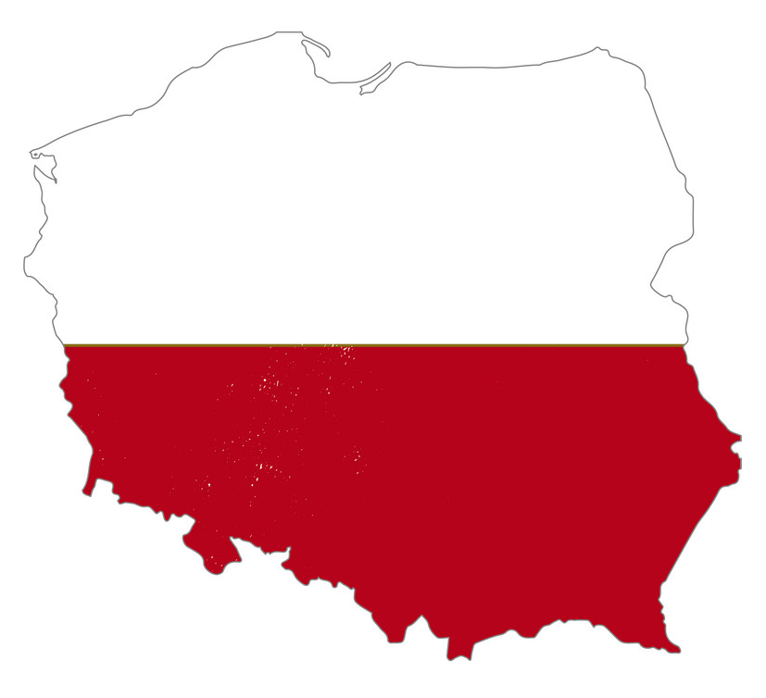
General Information
The Polish startup ecosystem is rapidly developing and holds significant potential
Significantly, 30% of Polish startups cooperate with corporations, 83% work mainly within the B2B model, and 46% of them do export activities
Most of the startups (60%) are on a problem-solution assessment and solution-product assessment stages of development.
The most popular industries among the ecosystem are Big Data (15%), IoT (14%) and Analytics (13%). Since 2016, Fintech startups are getting more and more popular (11% in 2018).
Four out of five venture capital investments take place at the seed round and 85 % of financing rounds from Polish venture capitalists range from €25,000 to €750,000.
Notes:
To date, Poland has spent close to €400 million on startups. The Polish startup ecosystem is rapidly developing and holds significant potential. According to the Polish Startups Report 2018, Polish startups who participated in the survey had received over €175 million in external funding to the date of publication of the report. Most of the startup founders in Poland are over 30 years old. Significantly, 30% of Polish startups cooperate with corporations, 83% work mainly within the B2B model, and 46% of them do export activities. Most of the startups (60%) are on a problem-solution assessment (i.e. formulating the assumptions of the business model and building a team) and solution-product assessment (i.e. intensive work on the product, registration of the company, prototyping, first revenues or users) stages of development. The most popular industries among the ecosystem are Big Data (15%), IoT (14%) and Analytics (13%). Since 2016, Fintech startups are getting more and more popular (11% in 2018). Around 100 VC funds are active on the Polish market. Four out of five venture capital investments take place at the seed round and 85 % of financing rounds from Polish venture capitalists range from €25,000 to €750,000.

Slide 38
Recent Improvements and Other Strong Areas
In 2016 Startup Poland foundation registered 2677 startup companies
Warsaw, Kraków, Poznań, Wrocław and Tricity were regarded as startup ecosystems
However, a half of the surveyed stated that they created a totally new products on a global scale, over 30% regarded their offer as precursory on a local scale.
Every second startup owner stated that modernity is in product, which is a key feature allowing the company to be regarded as a startup (Skala, Kruczkowska, Olczak, 2015, p. 41-47).
Notes:
In 2016 Startup Poland foundation registered 2677 startup companies in its database, which is a twelve percent progress in comparison with 2015. Warsaw boasts the largest number of them. Beside the capital city, also Kraków, Poznań, Wrocław and Tricity were regarded as startup ecosystems. The studies conducted by the foundation covered 697 operating companies and exhaustive analysis of the subsequent stages of their functioning. Analysis of the employment situation revealed that almost sixty percent of the surveyed described the number of jobs offered in a company between 1 and 10. Only one fifth of the startups employed more than ten persons. Over the last half-year over half of the firms created new jobs for on average two persons, in every fourth company between four and ten persons were employed and about 6% of the surveyed companies employed over eleven people. Totally over eighty percent of respondents indicated increase in job positions. The fact, disadvantageous from an employee point of view is that almost a half of all startups staff have no permanent work contracts, which results from the specific character of the branch (Skala, Kruczkowska, 2016, p.44-49). Despite the assumption of startup company innovativeness, only fourteen percent of the respondents possessed patents. However, a half of the surveyed stated that they created a totally new products on a global scale, over 30% regarded their offer as precursory on a local scale. Attention should be paid to divergences in defining innovativeness of activity. Every second startup owner stated that modernity is in product, which is a key feature allowing the company to be regarded as a startup. Moreover, entrepreneurs indicated the modernization of an existing product, innovation in the manufacturing process, organization, marketing or business model (Skala, Kruczkowska, Olczak, 2015, p. 41-47).

Slide 39
Examples of VC Fund Groups
MCI Capital (PL)- Focus on late-stage
Innovation Nest (PL)- Focus on Early-stage
RTA Ventures (PL)- Focus on Early-stage
PFR Starter FIZ- Focus on Pre-Seed and Early stage
PFR Biznest FIZ- Focus on Co-investing and early stage
PFR Funds: Mix of private and public investment funds for later stages
Notes:
MCI Capital (PL) Focus: Late-Stage Portfolio: 86 Most recent investments: Gett (IS)
Innovation Nest (PL) Focus: Early-stage B2B Portfolio: 32 Most recent investments: Prodsmart (PT), HCM Deck (PL)
RTA Ventures (PL) Focus: Early-stage Portfolio: 22 Most recent investments: MNM Diagnostics (PL)
PFR Starter FIZ - addresses innovative companies at their earliest stage of development (seed, start).
PFR Biznest FIZ fund of funds is investing through financial intermediaries (co-investment funds), cooperating and co-investing with business angels in innovative companies at an early stage of development.
PFR Open Innovation Fund - dedicated to SME companies which implement technological projects under the open innovation formula.
PFR KOFFI FIZ Fund - addresses entities from the small and medium-sized enterprise sector at the stage of growth, development/ expansion.
PFR NCBR CVC Fund is a Fund-of-Funds intending to invest in CVC & VC funds more than PLN 800 million and more than PLN 1,6 billion including private investor funds. This is the first Polish Fund-of-Funds providing financing in the CVC segment.

Slide 40
Examples of Good Incubators and Accelerators
Space3ac (PL) Focus: Tech startups Portfolio: 109 Benefits: Up to 200,000 PLN, mentoring, demo day at InfoShare
Cobin Angels (PL) Focus: Pre-Seed, Seed, Late-Seed Portfolio: 14 Benefits: Between 100,000 PLN and 2M PLN investment

Slide 41
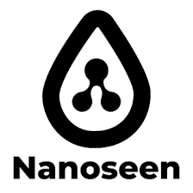
Examples of Successful Startups
Booste
SUPERSONIC Food
HiPets
Nanoseen
Exit Plan Games
Quantee
BioCam
Cthings.co
Notes:
Booste- a Szczecin-based startup that was founded in 2020 with one goal in mind – to modernize the way revenue-based startups get funding! You need to be an already established startup that operates either in the SaaS/Ecommerce business and has at least 6 months of consistent revenue. Once you send a request, they get back to you in a day with an offer. Then, you just pay back the money raised with an interest rate of 6-9% with no strings attached! They have so far raised €12.5 million
SUPERSONIC Food- positions itself as the food of the future. While we’re still certainly still living in the present, this is a Warsaw-based startup founded in 2020 that has taken on an investment of €600k to take us into the future! A healthy, wholesome, vegetable and perfectly balanced meal to be prepared in the form of a cocktail that nourishes, supports the building of immunity and delays the ageing process. SUPERSONIC Food is the perfect meal, containing properly balanced proportions of protein, complex carbohydrates, the best fats in the form of Omega 3-6-9 bioesters, fibre as well as micro and macro elements
City Robotics- is a Warsaw-based startup founded in 2020 and it is changing the future of robotics for the better. In doing so, it’s raised €1.2 million. At City Robotics they believe in creating robots to work alongside humans and not to replace them. Founded by a group of dedicated individuals who are never content with the status quo. They are pushing forward towards new and better solutions available for the masses
Doctor.One- is the next generation virtual clinic that helps doctors build a subscription-based private clinic. Warsaw-based, the startup has raised €440k, was founded in 2021 and is on a mission to help you get better access to a doctor online. With this in mind, they offer an unlimited number and time of consultations with your doctor through an easy-to-use chat. Your medical history is in one place that is being securely monitored and updated by your doctor. Fast and direct access to your doctor without long waits and distant appointments. And best of all – one subscription tailored by your doctor to your individual needs.
HiPets- is a Warsaw-based startup that aims to be the all-in-one platform for pet parents. It was founded in 2020 and so far has raised €680k. HiPets is a booking system for pet parents which allows them to instantly book services they need through their apps such as vets, groomers, behaviourists, and more. The goal is to eliminate waiting in lines and endless calls. Main features include online profiles, an online calendar, 24/7 bookings, text reminders and a client card.
Nanoseen- is a nano plastic purifier that is a Sopot-based startup and was founded in 2020. Their goal? What if they could solve the water crisis and give the world unlimited access to clean water? Nanoseen is a team of passionate nanotechnology engineers and scientists who prove the remarkable properties of the nanomaterials as a core component of the company’s products solving many problems related to climate change. In a few months after the company was founded, they raised €400k to create the world’s first solution to improve our lives – NanoseenX – the cheapest, desalination and water purification technology that does not need an energy supply.
Exit Plan Games- is a Warsaw-based startup that has raised €900k. Founded in 2019, FUN is what they want to deliver. New video games with fresh concepts that will be easy to just pick up and play. Games that we would like to play ourselves. And what about their Exit Plan? Well, it’s not exclusive just for them, as they want to share it with all the developers who still have it in them to make good games, while always aiming to maintain a healthy work-life balance.
Quantee- is a SaaS AI-based dynamic insurance pricing startup, based in Warsaw and raised €1 million. Founded in 2018, they empower insurance pricing teams with a secret weapon to successfully compete in the digital world. With Quantee, you can build better pricing up to 10x faster and update it in real-time, stay ahead of your competition and develop the most powerful models within hours instead of weeks or months, as well as easily understand results even for the most complex AI models with Quantee’s Explainable AI features.
BioCam- is a MedTech startup that increases the comfort of patients’ lives and provides new solutions for healthcare. They are a Wroclaw-based startup that was founded in 2019 and has up to date raised €1.89 million. Their endoscopy capsule allows finding lesions and pathologies thanks to a neural network that has learned how to search for them on captured images. Among the endoscopy capsule itself, they also provide AI-powered software for automatic detection and real-time determination of potential threats.
Cthings.co- is a Warsaw-based startup that creates and delivers 5G Suite of Industrial IoT Solutions: Hardware, OS, Orchestration SW for edge computing. The company was founded in 2018 and has so far raised €2.4 million. Cthings offers Intelligent systems for edge computing – complete, end-to-end solutions to upgrade your manufacturing, logistic park, utilities, or municipalities. They also offer 5G dedicated enterprise solutions, radar, and CLASP industrial trackers.

Slide 42
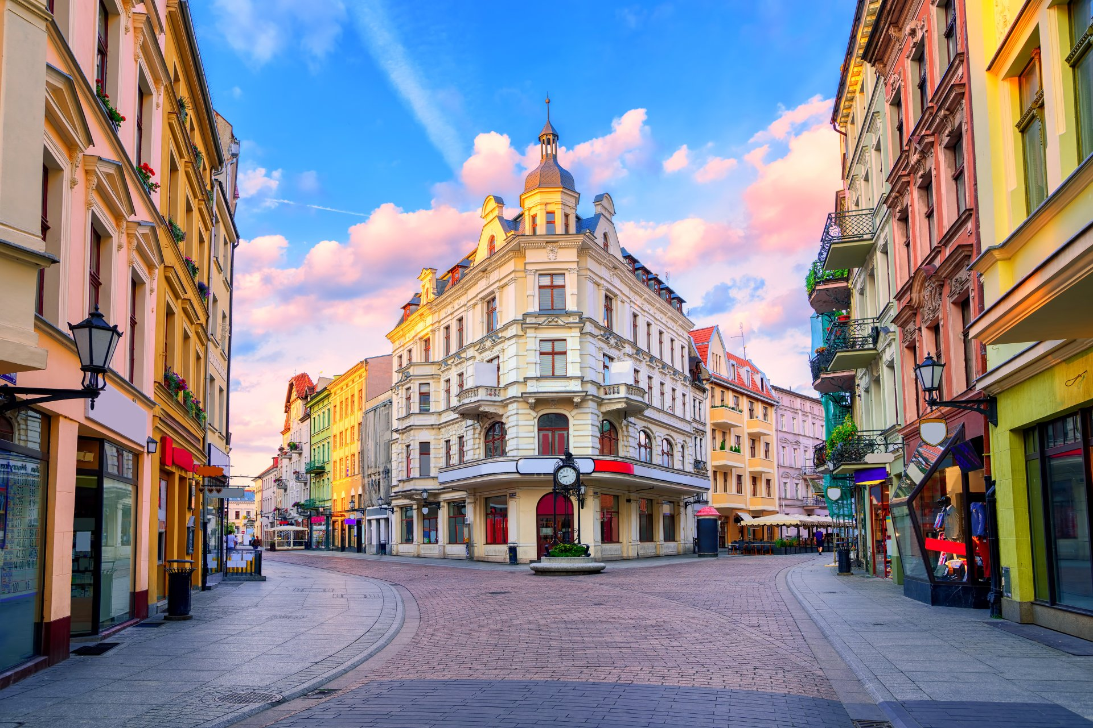
Challenges
Legislative barriers
Only one fifth of the startups employed more than ten persons
half of the firms created new jobs for on average two persons
6% of the surveyed companies employed over eleven people
Almost a half of all startups staff have no permanent work contracts,
only fourteen percent of surveyed respondents possessed patents
Notes:
Legislative barriers (visa policy, high requirements for establishing a joint-stock company), excessive engagement of the public sector into the investment process (81 % of the capital of VC funds comes from public sources).
Only one fifth of the startups employed more than ten persons
Over the last half-year over half of the firms created new jobs for on average two persons, in every fourth company between four and ten persons were employed and about 6% of the surveyed companies employed over eleven people
almost a half of all startups staff have no permanent work contracts, which results from the specific character of the branch (Skala, Kruczkowska, 2016, p.44-49).
Despite the assumption of startup company innovativeness, only fourteen percent of the respondents possessed patents

Slide 43
Looking Abroad: Lessons from Other Countries

Slide 44
Networking Aspects
Digital Hub in Ireland
Attractive environments for “digital nomads”
Greece’s “digital visa" to enable digital nomads to relocate to Greece with their families for three years.
Athens is also working to address other issues such as insurance, healthcare, tax regime, and infrastructure networks to provide a seamless experience for high-income remote workers.
Notes:
Digital Hub in Ireland provides a collaborative space for hundreds of local digital companies to scale and grow. Based in Dublin, this digital community was launched by the Irish government in 2003 in order to promote innovation in the tech sector. Some of their alumni include Slack and Stripe.
While some ecosystems focus on attracting companies, others (such as Bali and Lisbon) are more focused on creating an attractive environment for digital nomads. Greece is rising in the rankings and working towards a "digital visa" to enable digital nomads to relocate to Greece with their families for three years. Athens is also working to address other issues such as insurance, healthcare, tax regime, and infrastructure networks to provide a seamless experience for high-income remote workers.

Slide 45
Venture Capital
Japan- VC industry is maturing and driven by independent venture capitalists rather than corporate investment arms.
Large firms are increasingly partnering with startups
Japan’s VC industry matured with the rise of independent investors
Development of small-market-capitalization markets in the late 1990s made it possible for startups to IPO quickly
Notes:
The venture capital (VC) industry is maturing and driven by independent venture capitalists rather than corporate investment arms. Top-tier university graduates are founding startups and drawing elite human capital from large firms, the government, and universities. Large firms are increasingly partnering with startups to do things the large firms cannot easily accomplish by themselves. The number of university spinout startups is increasing rapidly, with a few growing into some of Japan’s largest startups. And the social legitimacy of the startup ecosystem is higher than at any point in at least the past half century; Japan’s major business federation, the University of Tokyo’s president, and the government’s economic strategy plan have all explicitly encouraged growth of the startup ecosystem.
Japan’s VC industry matured with the rise of independent investors leading the sector rather than the industry becoming dominated by VC arms of large corporations. The development of small-market-capitalization markets in the late 1990s made it possible for startups to IPO quickly, enabling VC to realize investment returns and function effectively. As VC returns increased, more people with relevant experience were drawn to the industry, increasing the opportunities for startups to get funded and VCs to realize further returns.

Slide 46
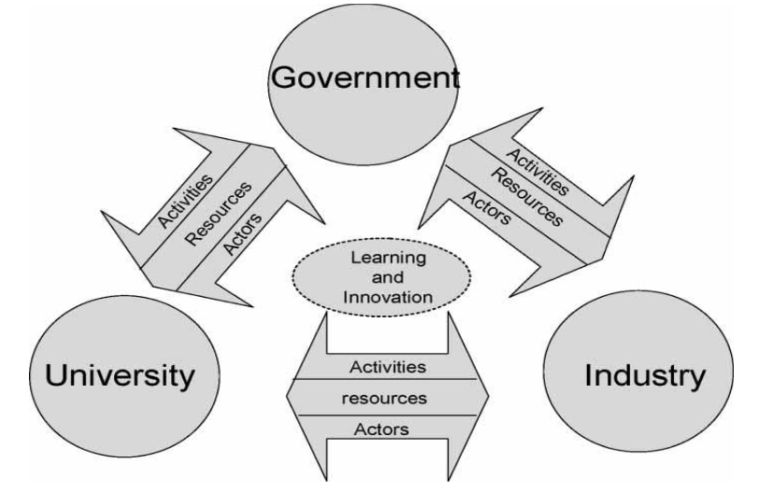
University-Government-Industry Ties
transformed regulatory reforms at national universities
enabling them to rapidly develop close ties with industry
government supports spinning out startups from university labs and research, and deepening collaboration between universities, industry, and the government.
https://silo.tips/download/a-conceptual-model-of-the-role-of-university-industry-collaboration-in-a-nationa
Notes:
University-government-industry ties have transformed with regulatory reforms at national universities, enabling them to rapidly develop close ties with industry in general, with a particular focus on feeding the startup ecosystem. The government actively supports spinning out startups from university labs and research, and deepening collaboration between universities, industry, and the government. Some notable successes and learning on both sides have led to further collaborations and spinouts. Overall, through a myriad of programs, the government has contributed to the startup ecosystem’s social legitimacy.

Slide 47
Social Legitimacy and Establishing an Ecosystem
it is not a good idea to try and “make a new” Silicon Valley, Boulevard of Broken Dreams
Japan- social norms surrounding the startup ecosystem transformed; startup ecosystem enjoyed real social legitimacy and widespread normative support
professional services supporting the ecosystem grew substantially, with law firms adding practice areas specializing in startups and some notable accounting firms even actively supporting the startup ecosystem by holding pitch contests and taking equity stakes in startups.
Large firms set up startup accelerators, incubators, and some early-stage investment funds in Japan.
Notes:
Universities in Silicon Valley (although it is not a good idea to try and “make a new” Silicon Valley, it has problems of its own such as monopolistic practices and previous attempts of re-creating it have generally not worked out great (Boulevard of Broken Dreams is a good book on this subject)
The social norms surrounding the startup ecosystem and entrepreneurship transformed significantly to the point that the startup ecosystem enjoyed real social legitimacy and widespread normative support. The startup ecosystem often made front page business news, with startup pitch contests, government-sponsored awards, and other publications and frequent showcase events.
Ecosystem Services Businesses: Finally, professional services supporting the ecosystem grew substantially, with law firms adding practice areas specializing in startups and some notable accounting firms even actively supporting the startup ecosystem by holding pitch contests and taking equity stakes in startups. Large firms as well as independent firms, even from Silicon Valley itself, rushed to set up startup accelerators, incubators, and some early-stage investment funds in Japan. Specialized startup ecosystem database firms and media that focused on the startup ecosystem thrived in helping to match large firms with startups. Once these support services and the myriad of opportunities were established, subsequent startups faced an environment in which it was easier to succeed, further bolstering the business of startup support services.

Slide 48
Starting an Optimal Setting for Start-Ups

Slide 49
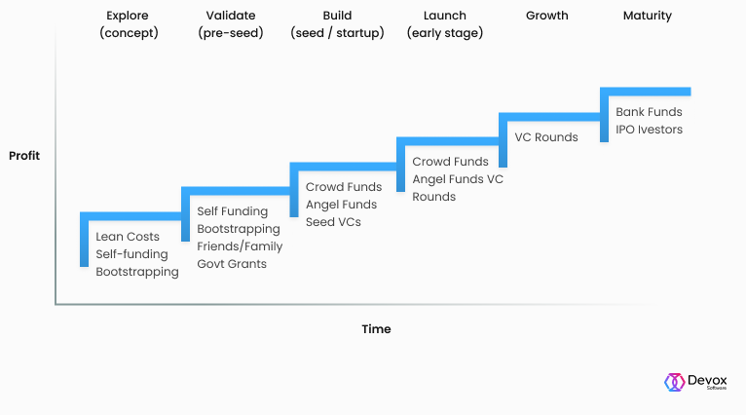
Startup Ecosystem in the V4
financial capital, human capital, social capital, legal regulations and institutional environment
The “top-down” approach: building ventures
The “bottom-up” approach: building up entrepreneurs
Notes:
Establishing startups is encouraged by large enterprises operating in city centres and focused on cooperation with other enterprises (Business to Business – B2B), but also by businesses operating internationally, which ensures for startups a more intensive and faster development (Nowacki, 2016, p. 59). Five areas were identified, whose proper functioning ensures development of startups and the whole system. These include: financial capital, human capital, social capital, legal regulations and institutional environment (Deloitte, 2016, p.4). Each area should be adequately analysed on the individual stages of establishing and running the company, determined according to: pre-seed, seed, early stage, expansion and late stage
There are two basic approaches to startup ecosystem creation: The top-down approach is focused on building ventures, and it measures success through immediate outcomes such as the number of startups, capital raised, and startup valuation. This approach is used by most entrepreneurship programs today and it requires aspiring entrepreneurs to get it right the first time around. The support system consists of government agencies, industries, universities, and existing entrepreneurs.
The bottom-up approach, on the other hand, focuses on building the entrepreneurs of tomorrow. It merges a community of forward-thinkers and mentors with resources in collaborative workspaces. This approach provides a steady supply of entrepreneurs. The ecosystem itself is the support, providing the entrepreneurs that have failed once get back on their feet and try again.
Combining these two approaches would provide a steady supply of ideas and initiatives and the institutional and financial support required to keep the ecosystem running for the long term.

Slide 50
Conclusions

Slide 51
Commonalities for the V4
CHALLENGES
Lack of funding throughout the stages of development
Disconnect between Academia and Businesses
SOLUTIONS
Government-supported VC funding
Government-University-Business Connections

Slide 52
Useful Sources
State of the Startup and Innovation Environment in the Czech Republic- Adél Kovács
https://www.xeurope.eu/post/startup-ecosystem-toolkit-visegrad
https://www.czechinvest.org/en/About-CzechInvest/About-Us
https://www.czechstartups.org/en/startup-ecosystem/
https://startupeurope.network/ecosystems/hu
https://www.researchgate.net/publication/316448977_Characteristics_of_the_start-up_culture_from_the_perspective_of_the_organizational_culture_model
https://www.researchgate.net/publication/322120447_A_Dynamic_Approach_to_the_Start-Up_Business_Ecosystem_A_Cross-Comparison_of_Korea_China_and_Japan
https://www.weforum.org/agenda/2022/05/how-startups-help-drive-economic-recovery-and-growth/#:~:text='An%20engine%20of%20change'&text=Technology%20startups%20are%20more%20than,economy%2C%20and%20attracting%20foreign%20investment.
https://emerginghumanity.com/learn-build-strong-startup-ecosystems
https://carnegieendowment.org/2022/08/10/how-japan-s-startup-ecosystem-grew-alongside-its-large-firms-pub-87636

