Slide 1
Universal health care (coverage) in Slovakia
Ing. Radovan Lapuník, MBA 2023

Slide 2
Slovakia in numbers
- population of over 5.4 million, developed, high-income economy
- in 2021 the 46th richest country in the world (out of 226 countries)
- GDP per capita 78% of the average of EU countries
- GDP per capita ranges from 188 % (Bratislava) to 54 % (Eastern Slovakia) of the EU average (regional disparities).
- Unemployment in 2021 – 6,7 % (7,1 % average of the EU countries).
- (1989) Slovakia successfully transformed from a centrally planned economy to a market-driven economy. Major privatisations are completed, the banking sector is almost completely in private hands, and foreign investment has risen.

Slide 3
Life expectancy at birth

Slide 4
Life expectancy at birth – EU comparison

Slide 5
UHC in Slovakia - history
From socialist health care HC (tax funded) to Bismarck social health insurance model based o PHI.
1993 – health care reform – the healthcare system was built in the following way:
- demonopolization (financing), plurality in purchasing of HC
- decentralization (decisions)
- deetatization (ownership – privatization)
- free choice
compulsory public health insurance - PHI (3 health insurance companies)
accumulation of resources, strong state regulations (health care market)

Slide 6
UHC definition
Universal health coverage means that all people have access to the full range of quality health services they need, when and where they need them, without financial hardship. It covers the full continuum of essential health services, from health promotion to prevention, treatment, rehabilitation and palliative care (WHO).
Universal health care (also called universal health coverage, universal coverage, or universal care) is a health care system in which all residents of a particular country or region are assured access to health care. It is generally organized around providing either all residents or only those who cannot afford on their own, with either health services or the means to acquire them, with the end goal of improving health outcomes.

Slide 7
UHC in Slovakia
Health care financing based on "welfare state" model – social Health Insurance Model (Bismarck)
"Everyone has the right to health protection. Citizens have the right for free health care and health insurance aids based on health insurance under the conditions established by law."
Article 40 of the Constitution of the Slovak Republic
Legislation
- Act of the National Council of the Slovak Republic No. 576/2004 Coll. about health care, related services with the provision of health care
- Act of the NC SR no. 577/2004 Coll. on the scope of health care covered on the basis of public health insurance and reimbursement for related services with the provision of health care
- Act of the NC SR no. 578/2004 Coll. about health care providers, health workers, professional organizations in the health sector
- Act of the NC SR no. 580/2004 Coll. about health insurance
- Act of the NC SR no. 581/2004 Coll. about health insurance companies, supervision of health care

Slide 8
Insurance payer/payer I.
1. Economically active persons (permanent residents)
- employee 4 % of the income basis after deduction
- employer 10 % of the gross employee income
- self-employed citizens 14 % of the income basis for insurance calculation, minimum 84,77 EUR/month (2023)
- Dividend payers – 14% of the income amount (max 67 980 EUR)
2. Economically inactive persons (permanent residents):
- Voluntarily unemployed persons – 14 % of the ½ average income of the country in the previous year (2023 – minimum 84,77 EUR/month)
- Insured person of the „state - unemployed slovak citizens registered at the labor office, pensioners, disabled person, children and students, parent on maternity leave etc.
3. Foreign citizens: students, employees, self-employed foreign citizens, azylum seeker etc.

Slide 10
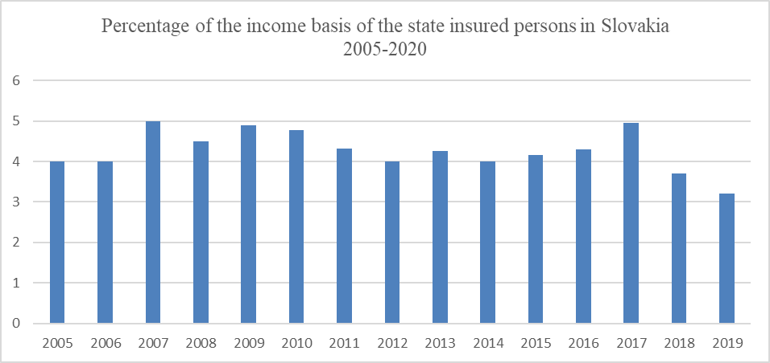
Insurance payer/payer II.
State insured persons (state budget – taxes):
Until 2019 between 3-5% of the average income of the country in the previous year. Since 2020 is the payment of the insurance state determined "operatively" by the law on the state budget.

Slide 11
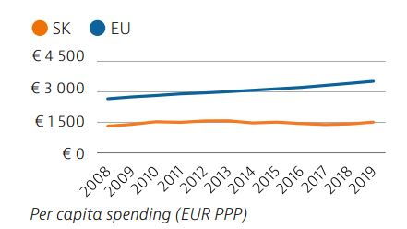
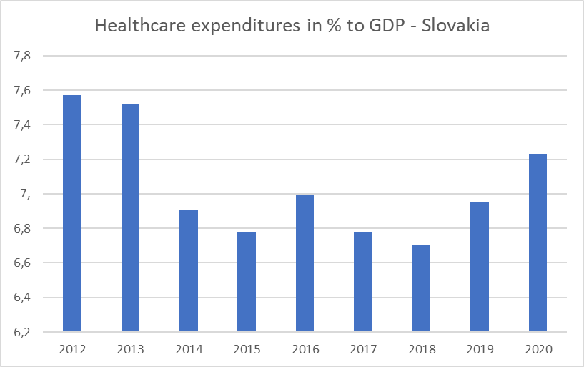
- Around 80 % of health spending is publicly financed, and out-of-pocket payments accounted for almost 20 % of health expenditure in 2019 compared to 15.4 % in the EU.

Slide 12
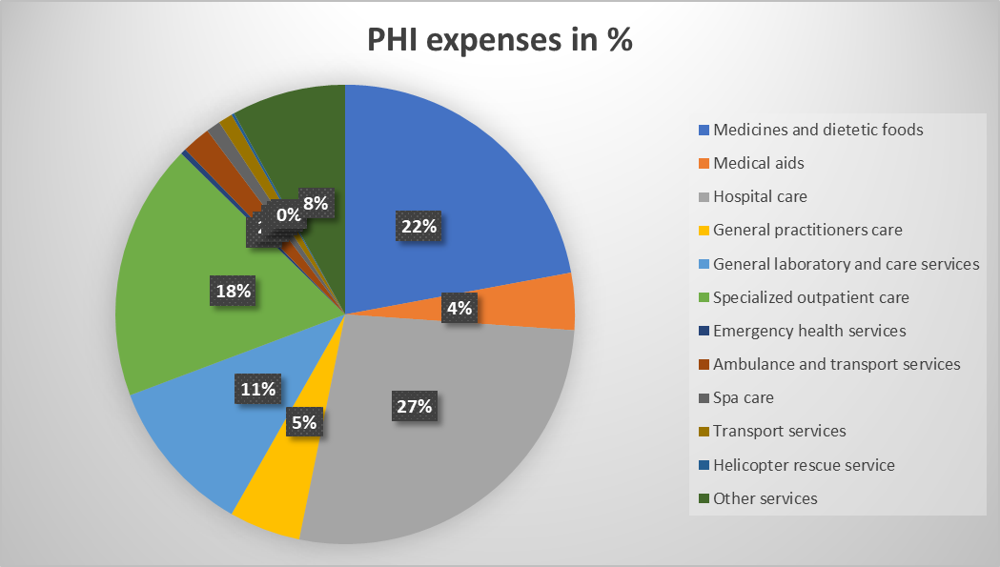

Slide 13
Problems of the UHC in Slovakia I.
The scope of healthcare to which a citizen is entitled from the public health insurance is defined very broadly in Slovakia. Many countries, mainly those with a public health insurance system similar to Slovakia, have a definition of a so-called basic healthcare package which clearly states what the patients are entitled to. Any changes in definition of the „free“ health care financed by PHI are limited to changes of constitution.
Because of limited PHI budget here is substantial cost-sharing through a system of user fees for certain health services, as well as co-payments for outpatient medicines (OECD). Dentist services are only partialy covere by PHI (doctors appointment, screening, basic services).
Limited PHI budget allows insurance companies to sign a contract only with limited health care provider (public minimum provider network – hospitals, general physicians, doctors specialists etc.). Free choice?
Health care services financed from PHI vs OOP (out of pocket)?
- Unpredictable amount of insurance payed for the state insured persons (since 2020).

Slide 14
Out of pocket spending (OECD, 2021)

Slide 16
Problems of the UHC in Slovakia II.
Although marginalised communities are largely state-insured, they still face barriers accessing care (geography, sociology). Roma communities account for about 8 % of people in Slovakia, and their health status is recognised to be worse than that of the general population (OECD) – lower life expectancy, higher mortality (segregation).
Overconsuption of health care services based PHI of certain groups (state insured citizens).
Slovakia uses a risk equalisation mechanism inspired by the Dutch mode l and is currently able to predict “only” 24% of average expenses (costly patients).
Concentration of the costly patients (state owned insurance company). System of redistribution of collected premiums based on age, risk factors, acitivity (economically active vs inactive) and profit limitation.

Slide 18
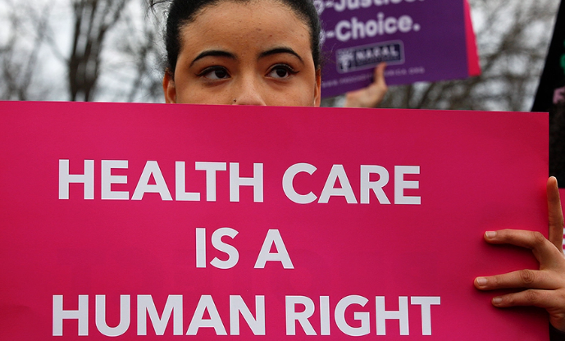
Thank you for your attention

