Slide 1
Slovak Defence Policy in the Regional Context and in the Backdrop of Hybrid Threats presentation for the Centre for Policy Studies, Armenia
Ján Cingel, CEO & Founder, Strategic Analysis, Slovakia
Yerevan, Armenia on November 21, 2022

Slide 2
Content of the Presentation
Introduction
Defence Policy of the Slovak Republic
Regional context of the Slovak Defence Policy
Hybrid threats
Cyber security – actors and responsibilities
Current challenges of the Slovak Defence Policy
Q/As

Slide 3
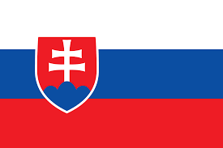
Introduction
Slovak Republic
Established: 1.1.1993
Capital: Bratislava
Population: 5,447 mil. (2021 census)
Total Area: 49,035 km2
Member of NATO (since 2004) and the EU (since 2004)
Parliamentary democracy with directly elected President

Slide 4
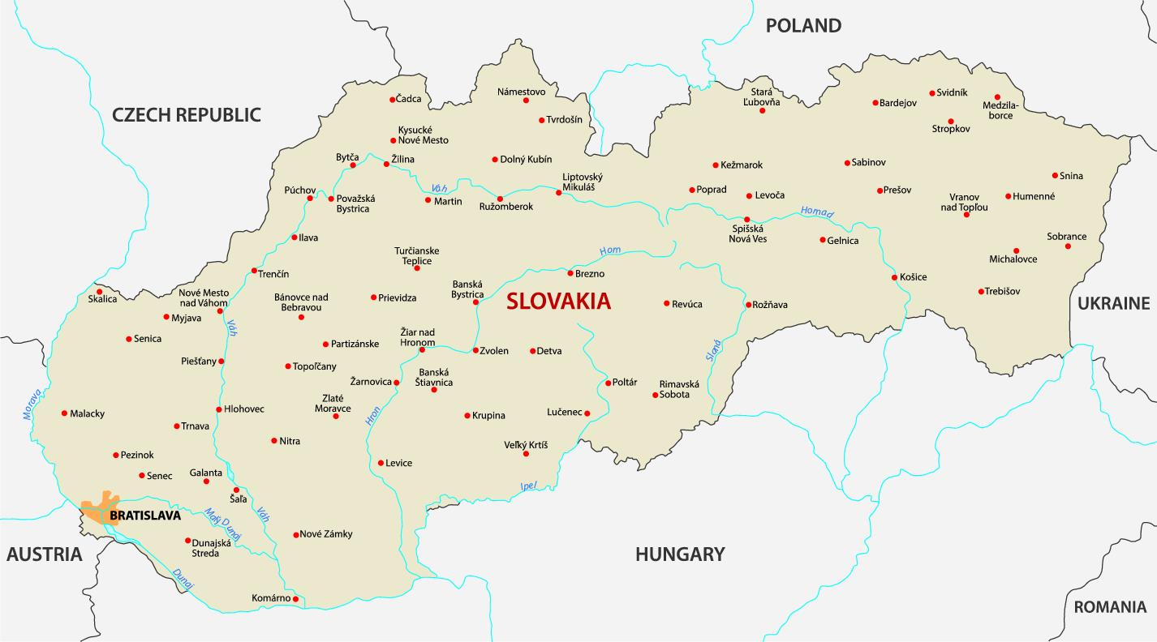
Map of Slovakia

Slide 5
Defence Policy of Slovakia Basic Facts
Armed Forces of the Slovak Republic
Division into:
Land Force: 14.800
Air Force: 3.200
Special Operations Forces: 1.500
Total numbers: 19.500 soldiers + 4.200 civilian employees
Ministry of Defence of the Slovak Republic
Military Intelligence of the Slovak Republic (cyber security at the strategic level – both defensive and offensive)
General Staff of the Armed Forces of the Slovak Republic

Slide 6
Defence Policy of Slovakia Basic Facts
Other Institutions of the Slovak defence and security system:
Police of the Slovak Republic (21.800 Police officers)
Customs Service of the Slovak Republic
Prison and Court Guard Service of the Slovak Republic
Slovak Information Service
National Security Authority of the Slovak Republic (cyber security at the national level, mostly the protection of the national network and the state institutions’ network)

Slide 7
Defence Policy of Slovakia Geopolitical determinants
Membership in NATO is essential – collective defence.
Membership in the EU – Common Security and Defence Policy of the EU + PESCO.
Visegrad Group cooperation in the defence area.
Current security environment – Russia’s invasion of Ukraine.

Slide 8
1. Defence Policy of Slovakia Sources
Security Strategy of the Slovak Republic (2021)
The security policy of the Slovak Republic is aimed at enforcing it security interests and responding to security threats and challenges in order to maintain and strengthen the security of the state. The Slovak Republic promotes its security interests through security policy instruments, for the contributions and support of citizens and in cooperation with allies and partners.
Defines vital Slovakia’s security interests:
Preservation of independence, sovereignty, territorial integrity and inviolability of borders; the rule of law and a democratic constitutional system; as well as the protection of life and health, fundamental rights and freedoms of its inhabitants.

Slide 9
Defence Policy of Slovakia Sources
Security Strategy of the Slovak Republic (2021)
Defines Security environment in which the Slovak Republic exists:
high rate of development dynamics and conversely a low level of predictability;
The importance and scope of non-military threats and procedures used by states to advance their interests is increasing;
The influence of authoritarian states promoting non-democratic value systems, as well as non-state actors, is growing;
Power competition between states for political, military and economic influence is intensifying;
Weakening of multilateralism and violations of international obligations of states in the field of security, growth of international tension and polarization, as well as unilateral actions continue several states;
Climate change;
The global terrorist threat remains high, starting from religiously motivated terrorism to its extreme right-wing and left-wing forms.
Erózia existujúcich režimov kontroly zbrojenia, odzbrojenia a nešírenia zbraní hromadného ničenia;
The extremely sharp global continues the competition for technological supremacy and the growing effort to gain strategic advantage and superiority in cyberspace.
The risk of endangering critical infrastructure is increasing;
The number and scope of subversive and coercive activities by various actors using disinformation and propaganda with the aim of disabling or manipulating decision-making mechanisms in the state, influencing public opinion in their favor and destabilizing the political situation is increasing;
The severity of global health threats is increasing, and they can take the form of unforeseen and uncontrolled threats to public health.
Continued growth of world population and ongoing demographic changes + illegal migration.

Slide 10
Defence Policy of Slovakia Sources
Security Strategy of the Slovak Republic (2021)
Defines Security threats against the Slovak Republic:
Armed attacked against the country;
Terrorist attack;
Cyber attack;
Attack on critical infrastructure or its damage;
Interruption of supplies of energy raw materials;
Hybrid threats;
Operation of foreign intelligence services;
Extremism and instigation of hatred;
Irredentism;
Illegal migration;
Organized crime;
Strategic corruption.

Slide 11
Defence Policy of Slovakia Sources
Defence Strategy of the Slovak Republic (2021)
The fundamental goal of the defense policy of the Slovak Republic is the preservation of its sovereignty, territorial integrity and inviolability of borders, which are a necessary condition state security. To fulfill this goal, it strengthens its own defense capacity and thus contributes to increase NATO and the EU's ability to act in the field of defense.
Important part is: „Building and development of the Armed Forces of the Slovak Republic“, where are defined promised contributions to the NATO and EU common defence frameworks (1 heavy mechanised brigade for purposes of NATO; one battalion for the NATO Enhance Presence; Rapid Reaction Forces contribution – one battalion group).

Slide 12
2. Defence Policy of Slovakia Regional Cooperation
Visegrad cooperation in the defence and security area: intensified in 2014, adopted V4 Ministers of Defence signed the first V4 defence cooperation strategy entitled Long Term Vision of the Visegrad Countries on Deepening their Defence Cooperation.
V4 Ministers of Defence adopted the revised strategy entitled Long-Term Vision of the Visegrad Countries on Deepening their Defence Cooperation on June 24, 2020. In the revised document, they reaffirmed their common interest in further developing the V4 defence cooperation and agreed the following four priority areas:
establishing multinational formations and contributing to multinational forces and initiatives,
harmonizing defence planning and capability development,
improving joint education, training and exercises to enhance interoperability,
cooperating with partners.
To implement the Long Term Vision multi-year Action plans are adopted.

Slide 13
Defence Policy of Slovakia Regional Cooperation – V4
Areas of the Cooperation
Since the adoption of the first Long Term Vision, V4 countries has substantially expanded their defence cooperation and implemented joint projects and activities in many areas stipulated in the document.
The regular formation of the V4 EU Battlegroup (BG) is one of the most important and visible results of V4 defence cooperation. Beside contributing to the EU’s rapid response capabilities, it strengthens interoperability and military interaction among the V4 countries. Until now, it has been set up twice, in first semester of 2016 and in second half of 2019, with Poland being the framework nation. The third stand-by period of the V4 EU BG will take place in the first semester of 2023. The V4 EU BG has also contributed to strengthening cooperation with other countries in the region by providing the opportunity to join. The V4 EU BG was reinforced by Ukraine in 2016 and by Croatia in 2019.
The establishment of the V4 Joint Logistics Support Group Headquarters (JLSG HQ) is another flagship project of the V4 military cooperation led by Poland and with the equal participation of the Visegrad countries.
Common trainings and exercises;
Capability development and procurement;
Visegrad Plus format.

Slide 14
3. Hybrid Threats
In Slovakia defined as a set of coercive and subversive activities, conventional and non-conventional, military and non-military methods, which state and non-state entities can use in a coordinated manner to achieve specific goals without a formal declaration of war and below the threshold of a usual reaction (according to the Concept of the Slovak Republic's fight against hybrid threats).
Hybrid threats threaten the functioning of democratic societies and attempt to weaken them from the inside by exploiting their vulnerabilities, but also their main achievements, including freedom of speech and expression, media independence, the rule of law, public control of institutions and democratic political competition or the openness of the market economy.
Often their intention is to deepen social and political polarization at the national and international level, political destabilization, incitement of social tension, undermining the credibility of state and public institutions and overall weakening of democratic decision-making and value orientation of society. As a rule, hybrid activities are also aimed at weakening public support for the fulfillment of the state's international obligations/pursuit of foreign policy goals.
The most prominent manifestation of hybrid activity in the Slovak Republic is the deliberate creation and dissemination of disinformation and increasingly intense and sophisticated cyber attacks.

Slide 15
3. Hybrid Threats
Slovakia:
In response to hybrid threats, the Slovak government approved in July 2018 the Concept for the fight against hybrid threats, which identifies the institutional framework for the field. According to the concept, the Situation Center (SITCEN) in the Office of the Security Council of the Slovak Republic fulfills the role of a national contact point for the issue of hybrid threats. In turn, the National Security Analysis Center (NBAC) plays the role of a national cooperation center for hybrid threats, i.e. gathers information about them from state administration bodies and evaluates them.
EU:
In April 2017, a joint initiative of the EU and NATO established the European Center of Excellence for the fight against hybrid threats in Helsinki, Finland, which brings together the expert community of both organizations in the field of hybrid threats. Slovakia has been a member of the center since August 2020.
NATO:
In 2015, NATO approved a strategy for combating hybrid threats.

Slide 16
3. Hybrid Threats
Areas where Slovakia recognizes Hybrid threats:
Cyber security
Energy security
Strategic communication
Interference by foreign actors and influencing electoral processes
Strategic corruption
Paramilitary and extremist groups

Slide 17
4. Cyber Security of the Slovak Republic
Brief Introduction I.:
Legal framework: April 1, 2018, Act No. 69/2018 on Cyber security, which comprehensively regulates the field of cyber and information security, introduces basic security requirements and measures important for the coordinated protection of information, communication and control systems.
The central authority of the state administration for the area of cyber security in Slovakia is the National security Office. Within their own competencies is mainly responsible for:
coordination, monitoring, control and evaluating the performance of tasks in the area of cyber security at the national level;
preparation of the Cyber Status Report security in the Slovak Republic and its submission for approval to the Committee for cyber security Security Council of Slovakia;
proposal and presentation of the procedure in the case cyber attack within the framework of the crisis management of the Slovak Republic;
ongoing monitoring of the national cyberspace and analysis potential and current threats;
is the national contact point for the EU and NATO in the area
In connection with the determination of the National security office as the central authority of the State Administration for Cyber Security has been operating since January 1, 2016, specialized department for solving computer incidents entitled Slovak Computer Security Incident Response Team (SK-CSIRT). Department provides services mainly related to management security incidents, eliminating them consequences and subsequent resumption of activity information systems in cooperation with the owners and operators of these systems.

Slide 18
4. Cyber Security of the Slovak Republic
Brief Introduction II.:
The law further determines that the Ministry of Defense of SR is to carry out actions to the necessary extent within the cyber security area, in particular:
after the declaration of war or declaring a state of war;
in times of crisis, if cyber a security incident threatens the system state defense and the ability to ensure defense of the state;
if information about cyber security incident indicate that a cyber security incident can be cyber terrorism, or can be used as a means terrorist attack and the measures taken did not lead to its removal in time.

Slide 19
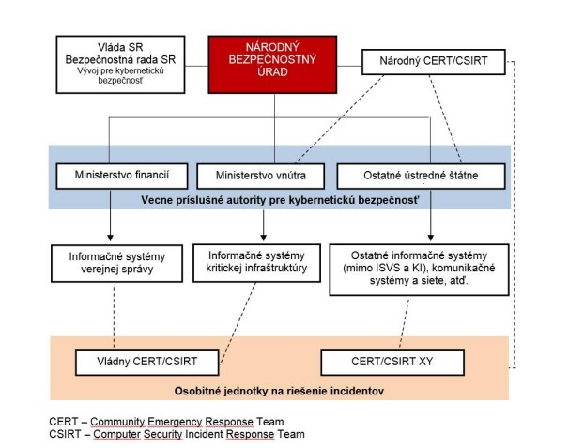
4. Cyber Security of the Slovak Republic

Slide 20
Current challenges of the Slovak Defence Policy
After February 24, 2022 the main task of the Slovak defence and security architecture is to cope with the either direct effects or side-effects of Russia’s invasion to Ukraine, in following areas:
Providing direct military technical assistance (S-300, Zuzana 2, Mig-29);
Providing humanitarian aid and assistance in Ukraine;
Providing training to members of Ukraine Armed Forces on its territory;
Providing assistance to refugees from Ukraine, passing through Slovak territory (around 800.000 people);
Coping with the hybrid threats – disinformation concerning the conflict, malign activities of hostile special services, forced illegal migration, cyberattacks on the Slovak infrastructure;
Arrival of NATO’s Forward Presence: 2.000+ troops from: Czechia, Germany, the Netherlands, Slovenia and the US.

Slide 21
Q/As:
Do you have any questions?

Slide 22
Thank you for your attention!
© Strategic Analysis s.r.o., 2022

Slide 23
Contacts:
Ján CINGEL, Founder & CEO, Strategic Analysis Slovakia
E-mail: jan.cingel@strategicanalysis.sk
Web: www.strategicanalysis.sk
Facebook: Strategic Analysis SK
Twitter: @StratAnalysisSK

