Slide 1
Crisis management – covid 19 in Slovakia
Ing. Radovan Lapuník 2023

Slide 2
Covid-19 in numbers
Positivity 1 860 506 cases (laboratory testing)
In Slovakia, the first case of the Covid-19 disease appeared on March 6, 2020, and the SARS-CoV-2 virus causing the disease Covid-19 was declared a pandemic by the WHO on March 11, 2020.

Slide 3
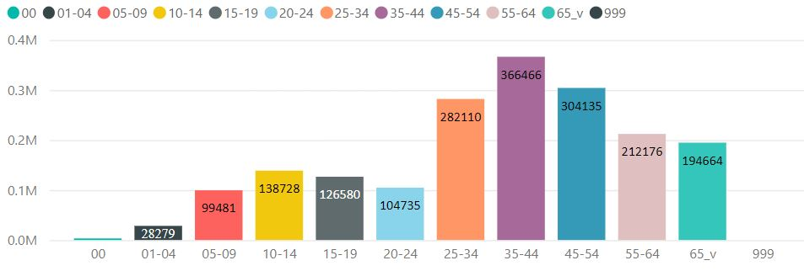
Covid-19 in numbers
Positivity cases by age
Laboratory testing was accessible in private and public laboratory facilities or testing sites (Ag).

Slide 4
Covid-19 in numbers
7,4 mil laboratory tests (red positivity 26,9%), 44,6 mil Agtests with 1,8 % positivity.
Laboratory daily testing capacity grew up from 500 in march 2020 to 42 000 in 2021/2022.
Nationwide and area testing for COVID-19 in Slovakia (during 2020) have helped capture hidden outbreaks and slow the spread of the virus, giving our doctors time and space to take care of the sick patients (positivity 0,7 % Agtests).

Slide 5
Covid-19 in numbers
Number of deaths 20 915 (blue – covid as cause of death, red – other cause bud positivity confirmed)

Slide 6
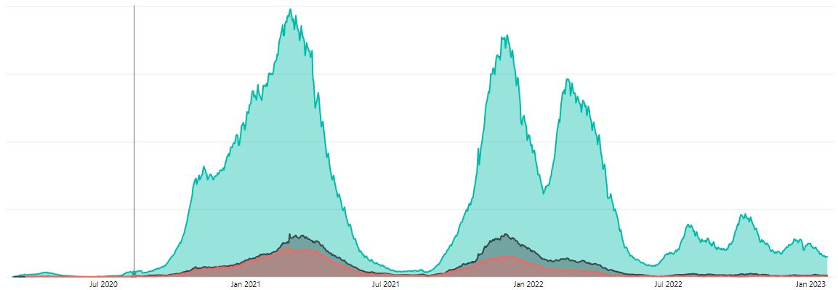
Covid-19 in numbers
Hospital admissions with Covid-19 (red- pulmonary ventilation, black – intensive care units).
During the Covid Pandemic 2,7 mil people got fully vaccinated (5,5 mil).

Slide 7
Management of the crisis situations in SR
Constitutional Act No. 227/2002 Coll. on the security of the state in time of war, state of war, state of emergency and state of emergency
State management in crisis situations is governed by two laws: Act no. 319/2002 Coll. on defense of the Slovak Republic, Act No. 387/2002 Coll. on managing the state in crisis situations outside of wartime
The principles of protection of residents during the negative consequences of extraordinary events are established by Act No. 42/1994 Coll. on civil protection of the population
Law no. 129/2002 Coll. about the integrated rescue system
Act No. 179/2011 Coll. on Economic Mobilization, Act No. 372/2012 Coll. on state material reserves, 576/2004 Coll. on health care, services related to the provision of health care, Act no. 578/2004 Coll. on health care providers, health workers, professional organizations etc.

Slide 8
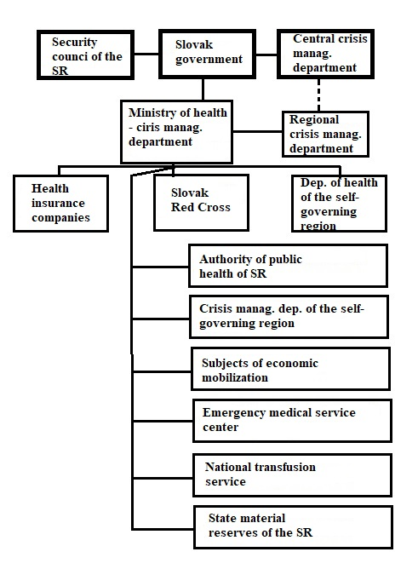
Scheme of subjects in the health crisis management system

Slide 9
subjects in the healthcare crisis management system I.
The Security Council of the Slovak Republic as an advisory body of the Slovak government, participates in the creation and implementation of the security system of the Slovak Republic, the fulfillment of international obligations in the field of security, evaluates the security situation in the Slovak Republic and in the world.
The government establishes a central crisis manag. department, which coordinates the activities of state administration bodies, local self-governed bodies and other components designed to solve a crisis situation during a crisis situation. The head of the central crisis staff is the Minister of the Interior of the Slovak Republic. During Covid-19 the Pandemic commission was established as an advisory body of government.
Crisis department MH SR - Crisis management is a system of workers and a specific management activity aimed at analyzing the possibility of crises in the healthcare system, their causes, possible consequences, and the search for measures and tools to prevent them and eliminate negative impacts in the event of their occurrence.

Slide 10
APH SR and crisis management
Authority of public health SR is under the auspices of implementing hygienic and anti-epidemiological measures, the aim of which is to ensure health care for residents, members of the armed forces and armed security forces and rescue and rescue units during a crisis situation. APH SR can submit a proposal to declare an emergency situation and also make a proposal to implement measures if the threat to public health exceeds the territorial scope of the regional public health office. 36 regional authorities of public health are coordinated by APH SR. APH SR (chief hygienist) was a member of Pandemic commission of the government.
On February 12, 2020, the Government of the Slovak Republic declared a state of emergency on the territory of the country, mobilizing civil protection units, which also include public health authorities. In August 2020, the Pandemic Plan was presented to the APH SR, which determined the roles of individual bodies of state administration and regional self-government during an infectious disease pandemic. Later, the "covid automat" was introduced. It is a manual (system), depending on the development of the epidemic, which anti-epidemic measures should be implemented in which phase.

Slide 11
APH SR and crisis management
Subsequently, on October 1, 2020, the Government of the Slovak Republic declared a state of emergency that lasted for more than 7 months (15/5/2021), which introduced restrictions on the mobility of residents, restriction of the right to assemble, and introduced work obligations for medical personnel (including employees of APH and RAPH in the Slovak Republic) and social workers, introduced the possibility of limiting the rights of individuals and imposing measures aimed at protecting the life, health and property of the population.
Crisis manag. department proposed anti-epidemic measures in consultation with the chief hygienist and experts in the field of anti-epidemic measures of public health authorities (wearing masks, restricting the movement of the population, restricting the operation of catering, sports and educational facilities, etc.).
At the regional level, a regional health crisis management department is established in each regional city. The task of the department is crisis management and coordination of medical facilities in the region in accordance with the instructions and standards of the Ministry of Health of the Slovak Republic.

Slide 12
Measures
Measures during state of emergency:
the obligation to wear a mask even outside,
a ban on mass events,
a ban on gatherings,
food purchased in establishments can only be consumed outside, or wrapped and taken with,
fitness, wellness, swimming pools, water parks were closed,
secondary schools used distance learning,
max. 1 person per 15m2 at shops and groceries,
food and drugstore reserved hours for seniors over 65 years old between 9:00 and 11:00,
restriction of free movement of residents (home office, free movement of citizens subject to testing and vaccination etc.

Slide 13
Information system and case management
During the Covid-19 pandemic, state and public administration authorities used multiple information systems that should communicate with each other. The basic system is the EPIS information system, in which positive cases of infectious diseases are recorded through hospital and outpatient health care. During the Covid-19 pandemic, the following systems were put into operation: 1. IS Covid - recording positive cases from laboratory examinations of public and private laboratory investigation units. The system is connected to EPIS, the 2nd system "My e-health", which received data from the IS Covid system of individual residents. The system is connected to the EPIS system.
The problem with the information systems was errors in their interconnection caused by erroneous personal data of persons and the subsequent erroneous reporting of a case in the EPIS system about one and the same person (possibly reported duplicates).
Web page https://korona.gov.sk/ was during the Pandemic the main source of information about the daily positivity, number of hospital admissions, testing and deaths. It offered possibility to make an appointment for covid testing, for vaccination or to get a covid card. It provides information about current measures, instructions about the disease, vaccination, testing pandemic work incapacity, covid information and telephone contacts to public authorities on the field of public health.

Slide 14
lessons from the pandemic
Low state owned laboratory testing capacity at the start of the Pandemic
Importance of accurate and fast information about the development of pandemic (information system). The Covid-19 pandemic showed the need to introduce a unified system that enables uniform reporting of positive cases from different types of investigation.
Importance of nationwide vaccination: According to a study of Pažitný (2022) could have been more than 12 000 lives saved. It could have been reached with higher rate of vaccinated citizens, contact with general practitioner within 14 days, prescription of antibiotics and previous overcoming of coronavirus infection. Reason could have been the distrust to vaccination and other measures because of antivaccination campaigns.
Missing legislation necessary for the implementation of measures on the field of Public health crisis situations (impending lawsuits). Legal acts to implement measures were only partialy legal, what was questioned by closed business owners and quarantined citizens.
Authority managing of state material reserves reacted late and did not have a supply of protective aids and equipment for state of emergency. It is necessary to maintain a certain minimum level of material stocks in case of their unavailability in the market.

Slide 15
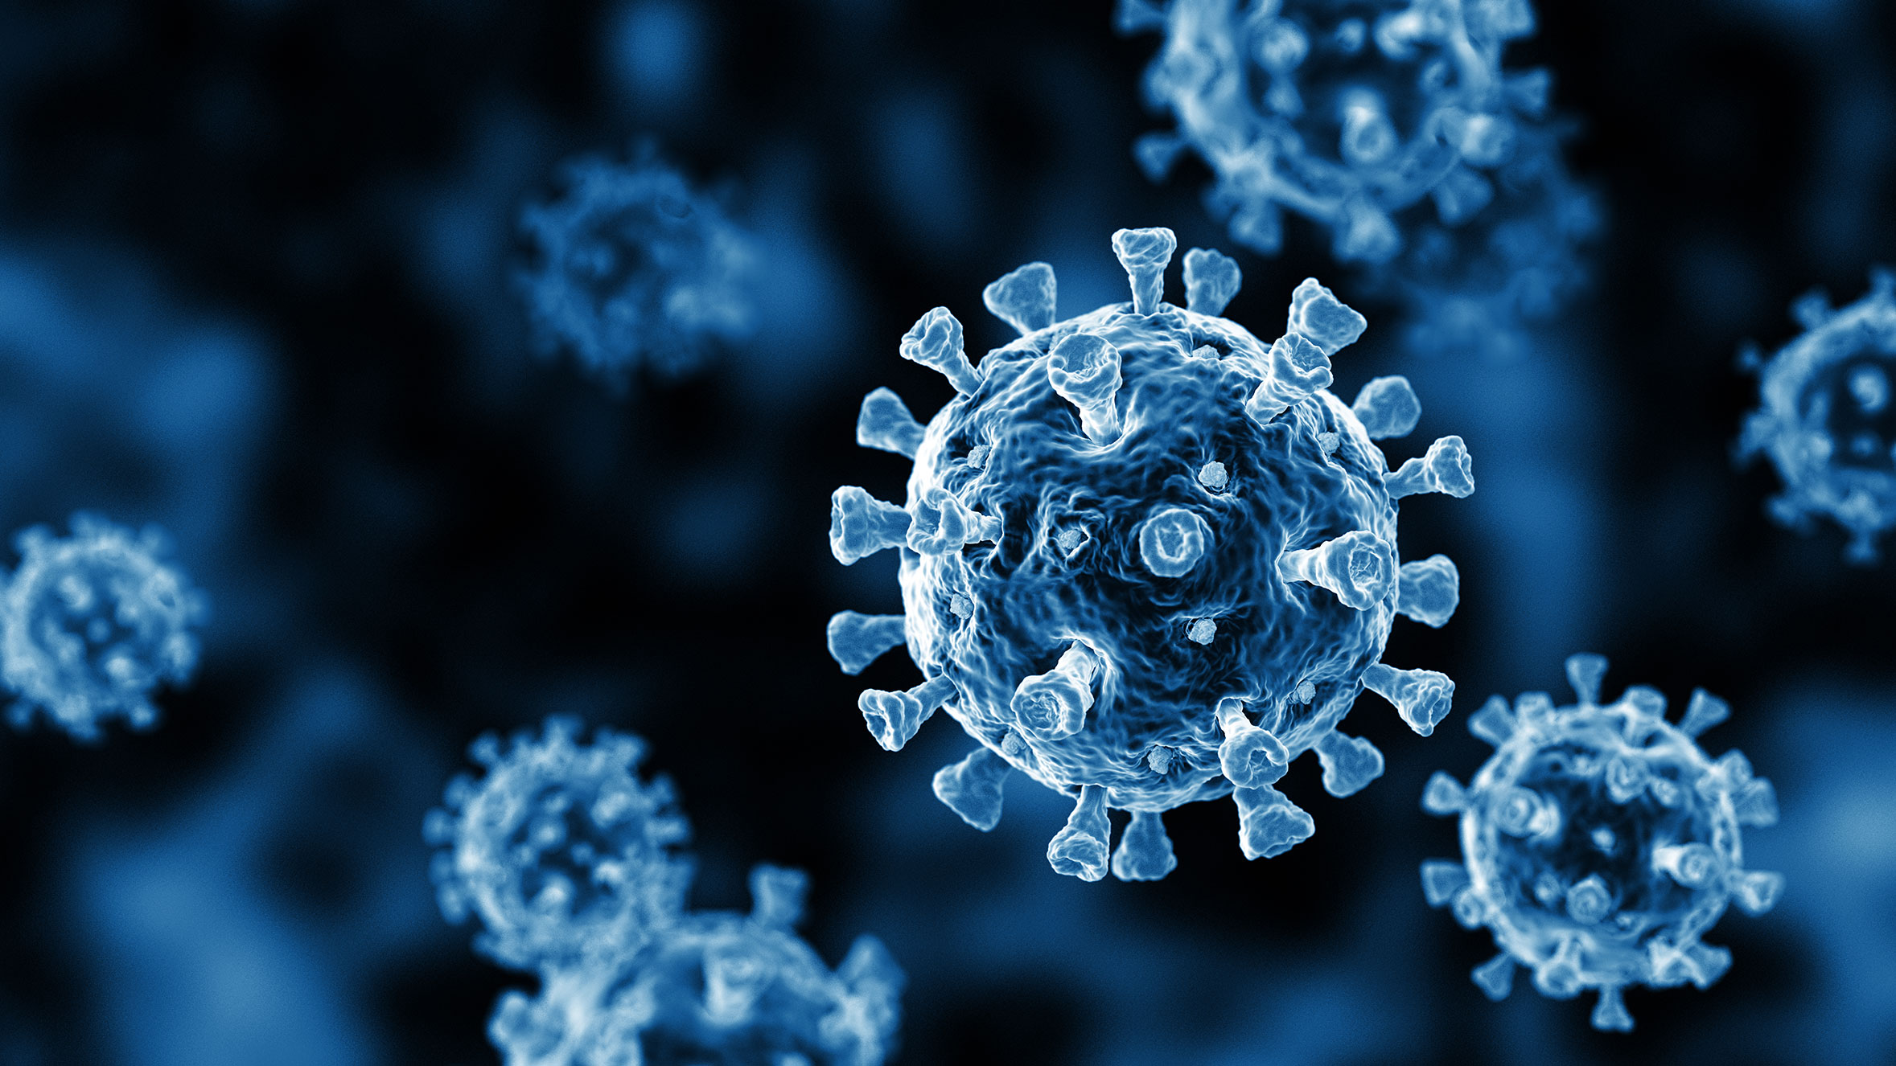
Thank you for your attention

