Slide 1



Tim Gittins
Institute for Entrepreneurship and Innovation
Corvinus University Budapest
Entrepreneurial Ecosystem Workshop
17 January 2023

Slide 2

Tim Gittins
Institute for Entrepreneurship and Innovation
Corvinus University Budapest
Originally from the UK, I have lived and worked in Hungary since 1996. I originally studied agricultural economics at the University of Reading, UK, and then worked in the UK government.
My teaching career spans over 30 years and I have taught in many business related areas in further and higher education in the UK and Eastern Europe. I have run my own consulting organisation in Hungary and hold a MBA from Henley Management College, UK. From 2010-2020 I worked as an online tutor with the University of Liverpool and completed a PhD on European SMEs with Johannes Kepler University, Linz, Austria in 2018.
I have worked as a professor of entrepreneurship at Corvinus University, Budapest since 2019. My main research interests are in informal entrepreneurship and entrepreneurial ecosystems.

Slide 3

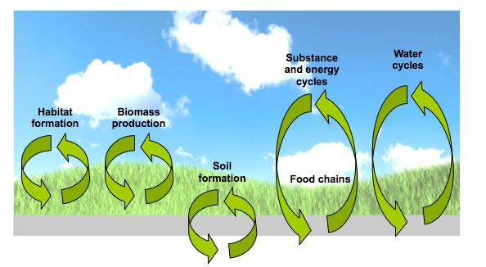
Introduction to Entrepreneurial Ecosystems
These have similarities with ‘natural ecosystems’ in that it can be assumed that circulation of innovation and business may be analogous to ecological cycles as depicted below.

Slide 4

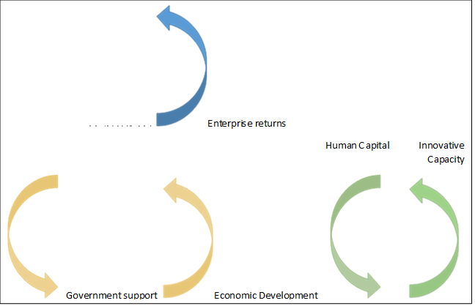

Entrepreneurial Ecosystem Cycles
VC investment

Slide 5
Entrepreneurial Ecosystem Cycles – Exercise
Decide which of the three cycles is most prominent in your own ecosystem.
VC investment

Slide 6

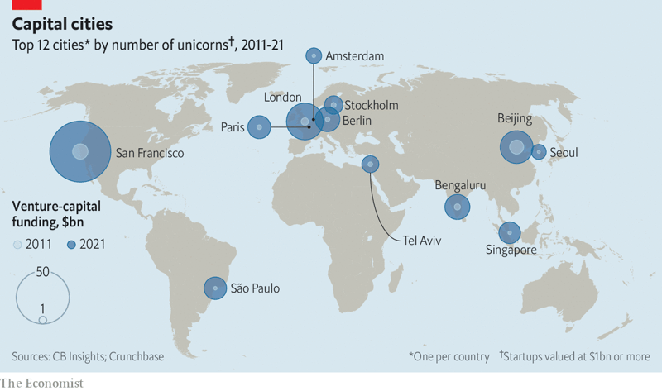
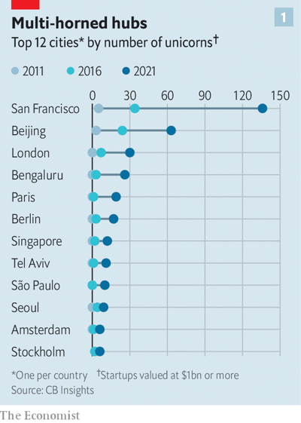
Entrepreneurial Ecosystems - Unicorns
https://www.economist.com/business/can-silicon-valley-still-dominate-global-innovation/21808708

Slide 7

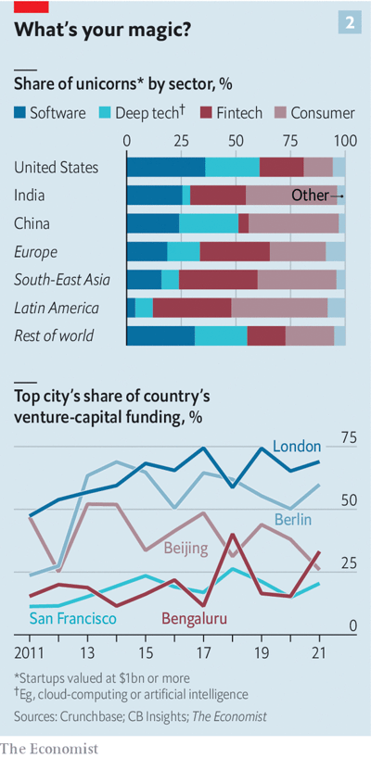

Entrepreneurial Ecosystems - Unicorns by Sector
Exercise:
What are the possible reasons for:-
A growing proportion of Fintech and Consumer Product based unicorns
Trends for VC funding in different cities
https://www.economist.com/business/can-silicon-valley-still-dominate-global-innovation/21808708

Slide 8


History of Entrepreneurial Ecosystem Theory
First reference to entrepreneurial ecosystems made by Moore (1993)
Triple Helix theory largely developed by Etkowitz (2003) incorporating the roles of Government, Universities and Private Business. Later expanded to ‘Quadruple Helix’ (Carayannis, 2009) adding an extra element of media and arts. The same author adds another element – Quintuple Helix – consisting of the overall environment.
Isenberg (2010) produced an influential model with several elements with the output being entrepreneurship.
Since 2015, several conceptual papers have appeared, notably from Stam (2015) Acs et al (2017), Audretsch et al (2018) and Spigel and Harrison (2018). A common theme is that ecosystem theory is underdeveloped and there is a lack of empirical application. Most research to this point tends to be qualitative in nature.

Slide 9
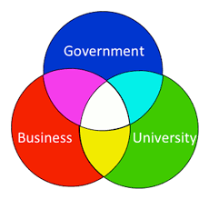
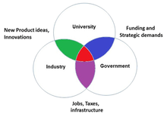
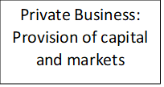
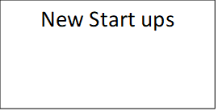
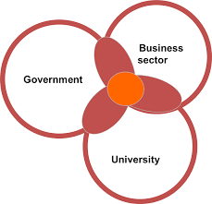
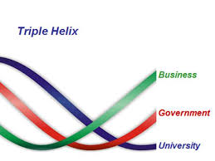
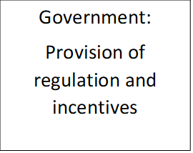
Triple Helix Concept
Universities: Provision of Knowledge

Slide 10

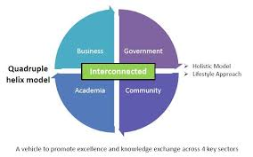
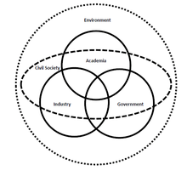
Quadruple/Quintuple Concept
Adapted from Carayannis and Campbell (2010).

Slide 11

Isenberg (2010) Model

Slide 12

Spigel (2015)

Slide 13
Spigel (2015) – Case Study

Slide 14
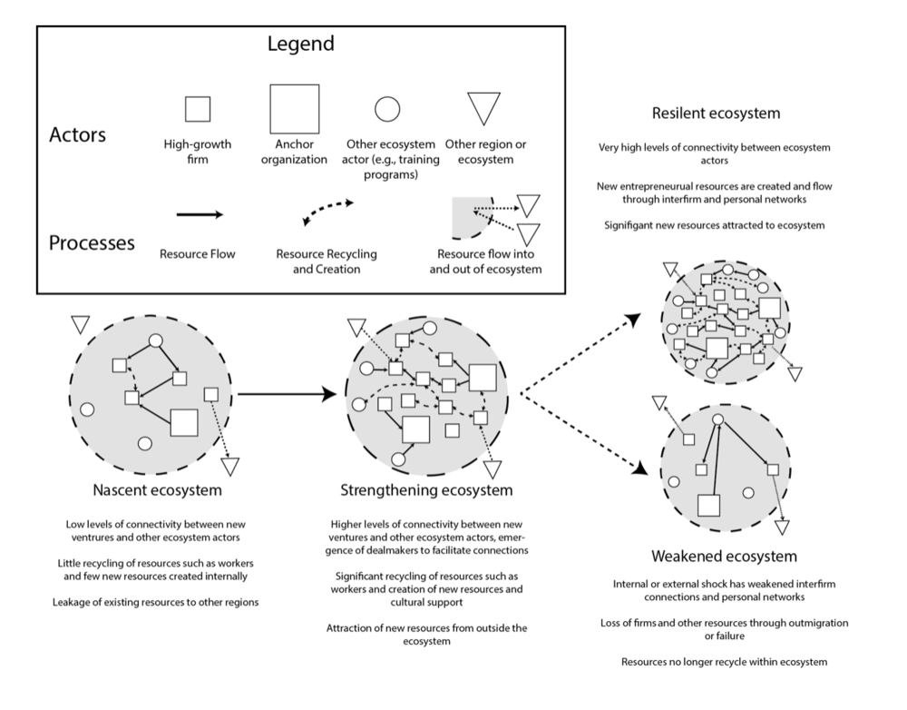
Spigel and Harrison (2018) model - I

Slide 15
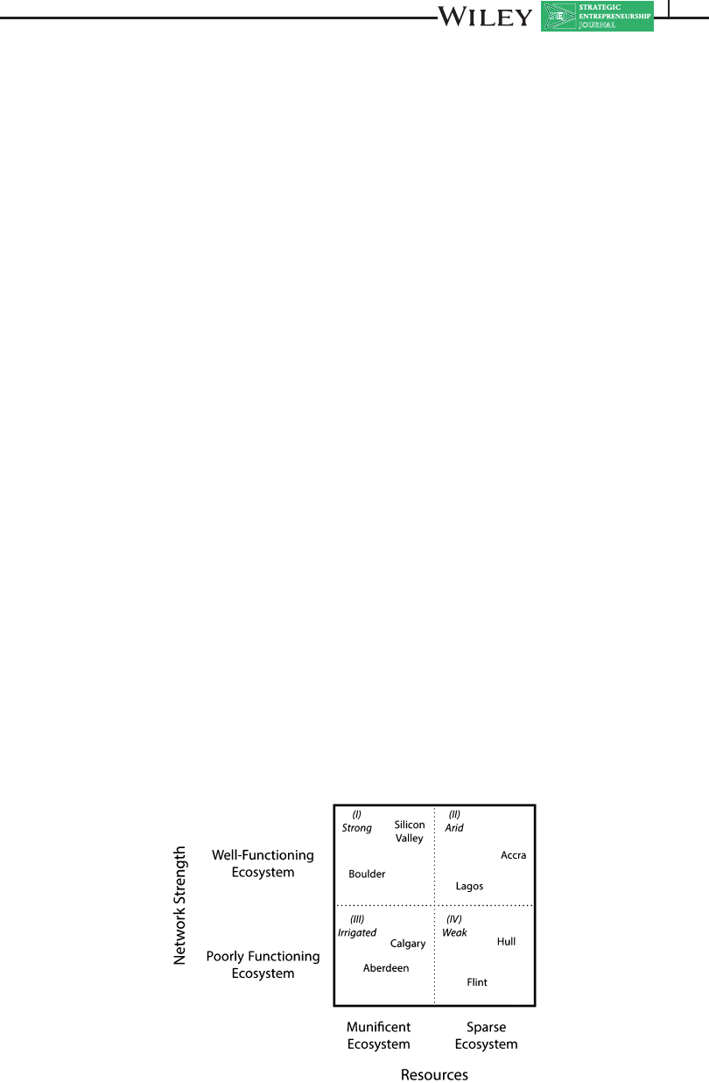
Spigel and Harrison (2018) model - II

Slide 16

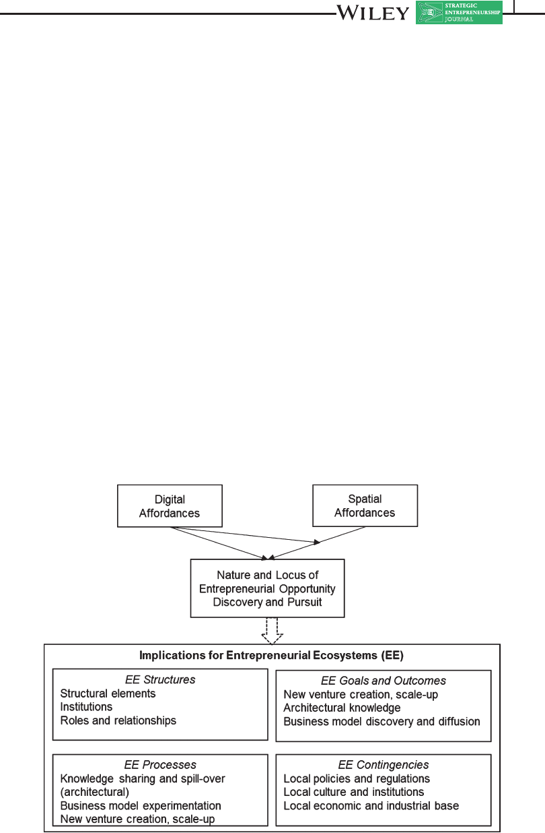

Autio et al (2018) - Digital Aspect

Slide 17
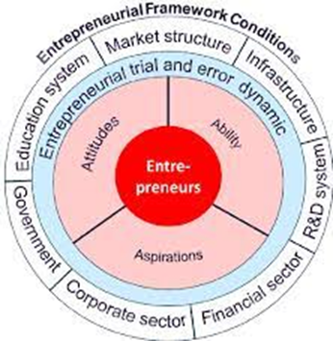
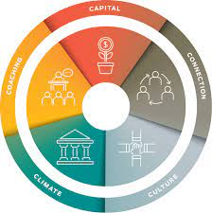
Ecosystem Models - Exercise
On the basis of the preceding models:
Discuss how useful you think they are in general in terms of understanding startup processes.
Decide which one you think is most applicable to your own locality.

Slide 18
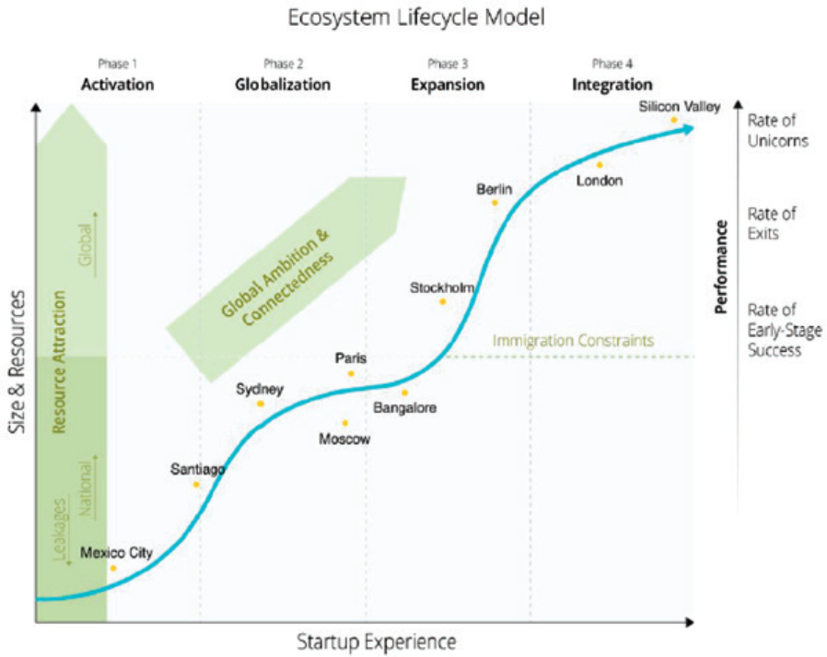
Brown and Mawson Model (2019)
Exercise: decide where you think your own city might be located on this chart

Slide 19
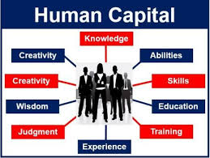

Human Capital
This can be defined as the ‘sum of skills, knowledge and capabilities’ of workers (Becker, 1964)
How can human capital be measured?
How might the concept of human capital fit with that of an entrepreneurial ecosystem?

Slide 20
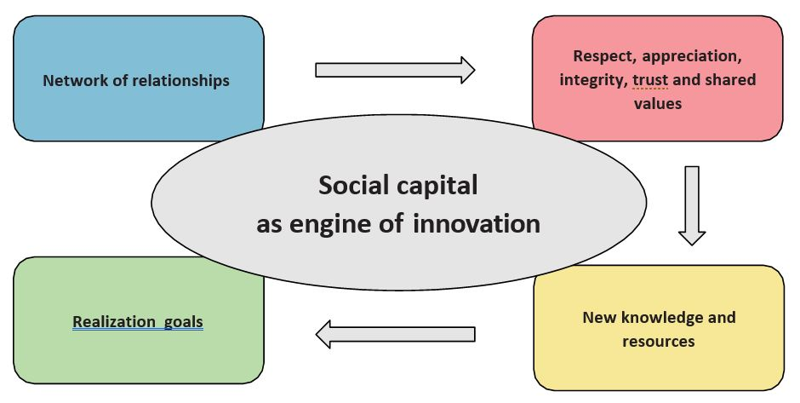
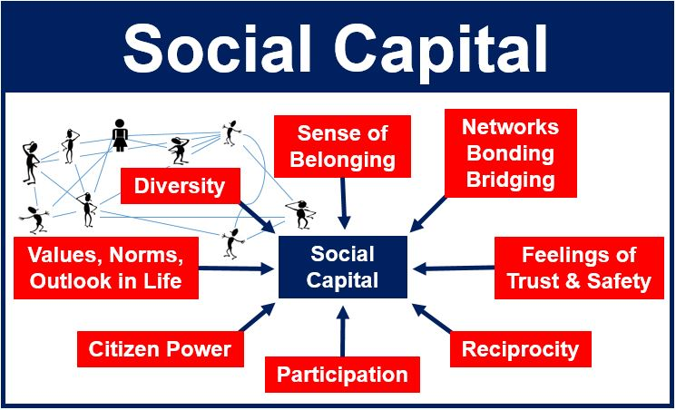
Social Capital
This can be defined as a ‘stock of business value’ accumulated by formal and informal means. (Napathiet and Ghoshal, 1988).
If I meet someone at a conference and exchange business cards with that person and then pass on the business card to someone else, who does the social capital belong to?
How does social capital accumulation fit the concept of an entrepreneurial ecosystem?

Slide 21

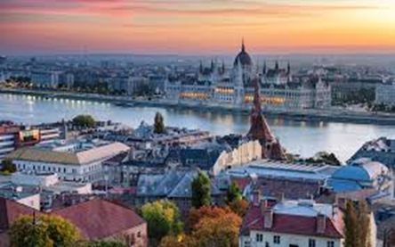
Budapest – IT Startups
Look at the chart below and:-
Identify the prominent trends
Identify problems with interpreting the data
Source: Compiled from publicly available data provided by KSH (Hungarian Central Statistical Office)
Number of Firms
Number of Employees | Zero | 1-4 | 5-9 | 10-19 | 20-49 | 50-249 | Total
2014 | 6.129 | 10.249 | 530 | 305 | 170 | 73 | 17.456
2015 | 5.993 | 10.503 | 526 | 319 | 176 | 73 | 17.590
2016 | 7.004 | 9.776 | 520 | 335 | 183 | 91 | 17.909
2017 | 6.894 | 10.748 | 524 | 345 | 217 | 101 | 18.829
2018 | 6.937 | 11.900 | 541 | 350 | 222 | 103 | 20.053
2019 | 4.851 | 15.021 | 529 | 380 | 227 | 119 | 21.127

Slide 22

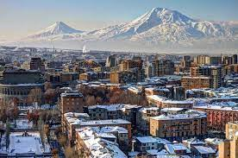
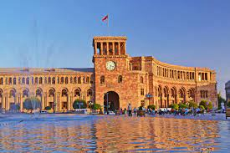
Yerevan Ecosystem
Universities: Provision of Knowledge
Exercise: With reference to the Triple Helix Model, identify areas of strength and weakness in the three ecosystem pillars for the Yerevan ecosystem

Slide 23



Yerevan ecosystem – main features
Higher Education
Technically oriented
Graduates stay in Yerevan
Private firms and universities offer entrepreneurial education but mostly class based.
IT events
Government
Networking events are involved
Tax incentives
Incubators
Accelerators?
SME financing is available
Business
Lack of private VC investors and angel investors.
Traditional MNEs not present to a large extent

Slide 24
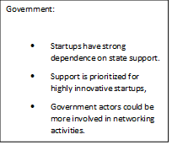

Budapest Ecosystem – Main Features
Universities:
Adequate provision of skilled graduates but do they stay in the city?
Lack of incubation activity.
Entrepreneurship education still tends to be class based.
Growing links with organizers of networking events.
Private business:
There is a very small private venture capital sector present in the city.
There are also very few angel investors
Multinational firms provide markets and linkages for startups.

Slide 25
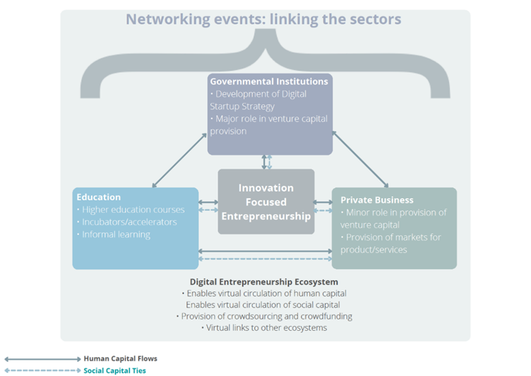
Budapest Ecosystem – Huszák and Gittins (2021)

Slide 26
References
Acs, Z., Stam, E., Audretsch, D., O'Connor, A., (2017), The lineages of the entrepreneurial ecosystem approach, Small Business Economics. 49 (1): 1-10.
Audretsch, D.B., Cunningham, J. A., Kuratko, D. F., Lehmann, E., Menter, M., (2019), Entrepreneurial ecosystems: economic, technological, and societal impacts The Journal of Technology Transfer. 44(2):313-325.
Autio, E., Nambisan, S., Thomas, L. D. W., & Wright, M. (2018). Digital affordances, spatial affordances, and the genesis of entrepreneurial ecosystems. Strategic Entrepreneurship Journal, 12(1): 72–95.
Becker, G.S., (1964) Human Capital. New York, Columbia University Press.
Carayannis, E. G., Grigoroudis, E., Campbell, D. F. J.. Meissner, D., Stamati, D., (2018), The ecosystem as helix: an exploratory theory-building study of regional co-opetitive entrepreneurial ecosystems as Quadruple/Quintuple Helix Innovation Models. R&D Management. Vol. 48 Issue 1, p148-162.
Etzkowitz, H. (2003): Innovation in Innovation: The Triple Helix of University-Industry Government Relations. Social Science Information, 42, (3): 293-337.
Huszák, L., Gittins, T., (2021), Understanding the Budapest Entrepreneurial Ecosystem: Human Capital Flows and Social Capital Ties, Central European Business Review, Vol 11.
Isenberg, D. J. (2011). The entrepreneurship ecosystem strategy as a new paradigm for economic policy: Principles for cultivating entrepreneurships, The Babson Entrepreneurship Ecosystem Project, 1(781): 1–13.
Moore, J.F. (1993), “Predators and prey: a new ecology of competition”, Harvard Business Review, Vol. 71 No. 3, pp. 75-83.
Nahapiet, J,. Ghoshal, S., (1998) Social capital, intellectual capital, and the organizational advantage. Academy of Management Review, 23 (2), 242–266.
Pugh, R., (2017), Universities and economic development in lagging regions: ‘triple helix’ policy in Wales. Regional Studies, Vol. 51 Issue 7, p982-993
Stam, E., (2015), Entrepreneurial Ecosystems and Regional Policy: A Sympathetic Critique. European Planning Studies, 23 (9): 1759-1769.
Spigel, B. (2017). The relational organization of entrepreneurial ecosystems. Entrepreneurship Theory and Practice, 41, 49–72.
Spigel, B., Harrison, R. (2018). Toward a process theory of entrepreneurial ecosystems. Strategic Entrepreneurship Journal, 12(1), 151–168.

Slide 27
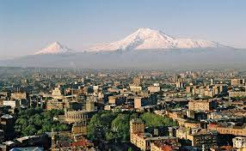

Thankyou for your attention!

