Slide 1
DIGITALISATION OF PUBLIC SERVICES IN THE CZECH REPUBLIC
Jan Havlíček
December 12-14, 2022
Yerevan, Armenia

Slide 2
Digital Economy and Society Index 2022
Czechia ranked 19th out of 27 in 2022
Previous 5 years Czechia has continued to show improvements
Czechia improving above the average rate of the EU

Slide 3
Czechia DESI Performance
Compared to the EU the Czech Republic has poor connectivity.
There is room for improvement on the integration of digital technology
Human capital is on par with the EU average.

Slide 4
EU Digital Decade Targets
The Czech Government is basing its policies for digitalisation on these goals, particularly:
- Connectivity
- Basic Digital Skills
- Key Public Services 100% Online
- E-Health
- ICT Specialists
- Tech Up-Take

Slide 5
Connectivity in Czechia
Czechia ranks 17th in the EU
There has been slow improvement across all aspects of connectivity from the last two years
In nearly every category Czechia is not on par with EU averages

Slide 6
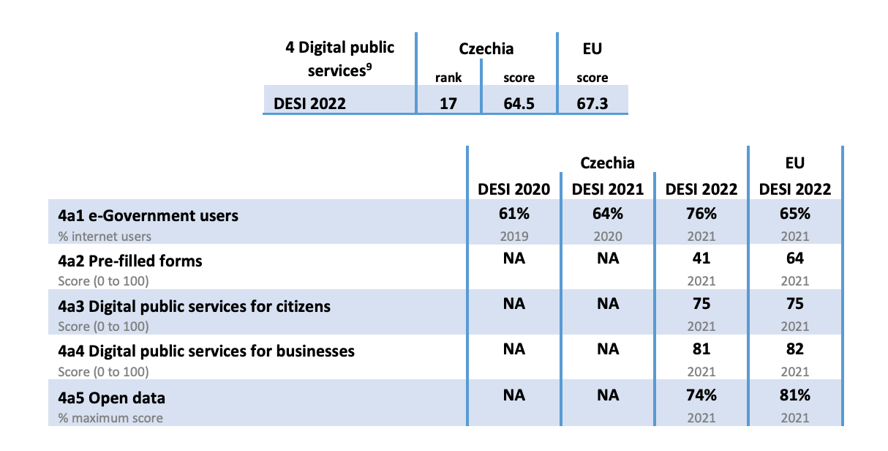
Digital Public Services in Czechia
Czechia ranks 17 out of 27 countries
There is a distinct low number of Pre-filled forms
Above average number of e-Government users

Slide 7
Monopoly on Telecommunications in Czechia

Slide 8
Banking Identity Project Czechia
Project was initiated in 2017.
Aims to allow people to internet bank remotely
Through their identification people can access public administrations online.

Slide 9
Digital Czechia and E-Government
Digital Czechia strategy was devised in 2019.
Plan to have the country fully operational digitally by 2025.
Czech Republic also launched its first ever census via electronic form.

Slide 10
Problems Facing Digitalisation
Czech public administrative bodies are using technology from the 1990s.
Reliant on external service providers for upgrades to the system.
New users are required to visit a public office in person to confirm their identity.

Slide 11
What Comes Next For Digitalisation?
The government must ensure a digital democratic space in the future.
Social media is operating outside of the traditional media laws.
EU has written several legislative acts to prepare for the future digital age.
New laws must focus on principles that can be applicable in situations where the law is too slow to catch up.
Take a risk-based approach to regulating technology.

Slide 12
Aiding and Advancing Digitalisation
Czechia should look to emulate the successes of the Baltic states.
Education is critical for overcoming obstacles of digitalisation.
The sudden transition due to COVID showed the gaps in the process of digitalisaiton.

Slide 13
E-Mobility
It must better people as well as corporations and municipalities.
The user is important in the expansion and promotion of it.
At a broad European level there is a general consensus on E-Mobility.
The states at an individual level are not prepared for it.
E-Mobility can play a key role in Europe’s carbon neutrality plans.

Slide 14
E-Learning
Digital solutions cannot fully replace in person education with social contact.
There must be a balanced approach going forward between in person and online.
The main challenge is keeping the community of a school in a digitalised environment.
There should be a society wide approach to fixing problems caused by the digitalisation of education.

Slide 15
Healthcare in a Digital World
Czech society still dealing with the failure of the IZIP project in the 1990s.
Government must change the idea that investing in healthcare means new hospitals.
A key success at digitalising is the enactment of common interface for application programming, API.

Slide 16
Cybersecurity
The state is essential for building necessary cybersecurity infrastructure.
A society-wide approach is the best to implement cybersecurity.
Microsoft is working with the government to digitalise security in healthcare.

Slide 17
Protection of data
Czech National Security Strategy for Cybersecurity:
National capabilities
International cooperation
Building a resilient society
Government should not over nor under regulate technology
Data has become a strategic raw material similar to oil and natural gas.

Slide 18
Other Threats Affecting Digitalisation
Czechia is lagging behind in engagement with international research.
Inability to attract foreign leaders in the cyber industry.
There is excessive orientation towards foreign research in specific fields.

Slide 19
Concluding Remarks
Czechia has continually improved in the area of digitalisation for the previous 5 years.
The government must continue to work to overcome challenges the industry is facing.
These challenges provide excellent opportunities for the country to grow and improve.
Czechia should continue to work within the realm of the European Union when facing challenges.

