Slide 1
COVID And Policy In Hungary 2020-2021
Lessons for Armenia
Balázs Váradi
Centre for Policy Studies / Visegrád Fund, Yerevan, Armenia
14 December 2022

Slide 2
Why me?
  Economist / Public Policy Analyst
  Before: academic
  2007-2008 senior adviser to the prime minister
  Since: policy analyst, at the Budapest Institute for Policy Analysis, an independent think tank (and lecturer)
  2020-21 Worked in the COVID workgroup of the Hungarian Society of Health Economists

Slide 3
Why Should Armenia learn from hungary?
  Shared Semashko heritage
  Size (population: 3M – 10M)
  Domestic political situation (both: „partly free” by Freedom House)
  But I know that every country context is different

Slide 4
Hungary: healthcare and geneRal policy Background
Notes:
Armenia life expectancy at birth: 75

Slide 5
In sum: below the curve

Slide 6
Pandemic: long time, no see
Biggest such challenge since the Spanish flu of 1919
Some defences for flu or AIDS, but (despite
readiness exercises) nowhere for this
Not just public health measures: social policy,
education policy, economic policy, security, political,
etc.
Ex ante looked esp. apocalyptic (70% X 1-5% deaths)
A sort of natural experiment

Slide 7
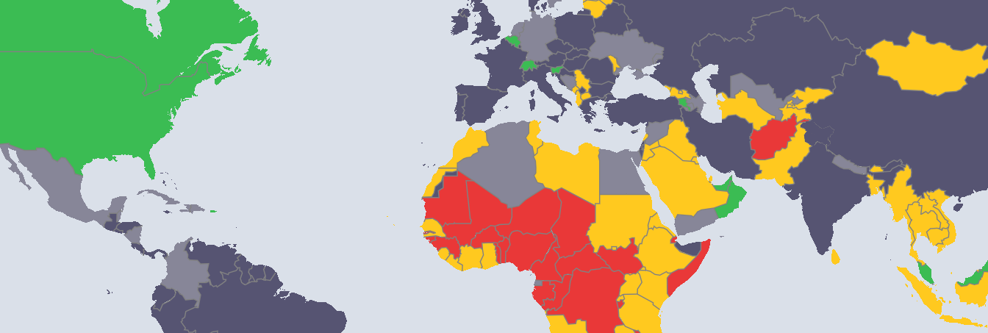
Readiness: Not very good, but similar to others
https://preventepidemics.org/map/
Notes:
The last vestige of socialism…

Slide 8
When Covid came to Hungary
Notes:
STOP HERE – WHAT DO YOU THINK? WAS IT A SUCCESS?

Slide 9
Measures in General: Healthcare
Public Health: quarantine, curfew (enforced by policy and
army (*)), mask mandate, school closures etc. – generally in
line with other EU countries
Equipment procurement: chaotic and probably
corruption-ridden (*)
Testing: rather limited (*)
Hospital capacity reallocation: brutal and abrupt (*),
including suspension of screening and elective (?) surgery
Changing the financing incentives: freezing transfers
Radical HR changes in healthcare: wage hike for doctors
and nurses but quasi-militarizing their job status (*)
Vaccination: Chinese and Russian vaccines first (*), late but
relatively efficient, somewhat disorganised waves with the
EU-procured vaccine
In sum: mostly in line with EU MS practice, w. idiosyncracies
Notes:
COVID incl. screening suspension had adverse effects – we know

Slide 10
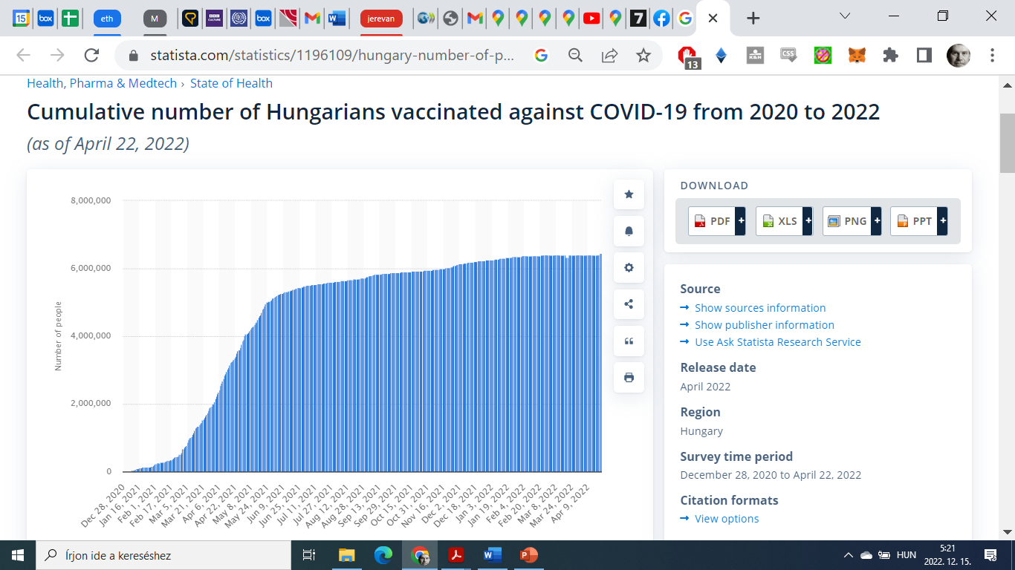
Vaccination rates

Slide 11
School closures
Notes:
At first the govt resisted, then swift U-turn

Slide 12
Measures in General: Economic & Social measures
Transfers to employers who committed to not firing
employees (*)
Including non-COVID related white elephant projects
No universal monetary transfers to people (*)
Widespread suspension of debt servicing
Economic measures: 20% of GDP but only 0.6% on HC directly
Free parking in cities
No amnesty in jails (*)
Very little attention to disadvanteged social groups
(e.g. the Roma) (*)
In sum: stingy and idiosyncratic
Notes:
Paks Nuclear Plant, Belt-and-Road railway upgrade,…

Slide 13
Measures in General: Politics and communication
Widespread powers to govern by decree passed by
the govt supermajority in Parliament (some retained to this day V-Dem „pandemic violations” worst in EU ) (*)
Initially trying to blame foreign (Iranian) students for the plague (*)
Hypercentralized, limited communication. Example: the weekly reports (https://www.nnk.gov.hu/index.php/koronavirus-tajekoztato/1815-48-het-enyhen-emelkedik-a-szennyviz-koronavirus-koncentracioja ) and the centimeter method by CRCB (*)
Centralizing resources and power away from local government to the central government (*)
Notes:
For and against total transparency in policy design…

Slide 14
In comparative terms: a failure of health policy…
Notes:
Tragedy

Slide 15
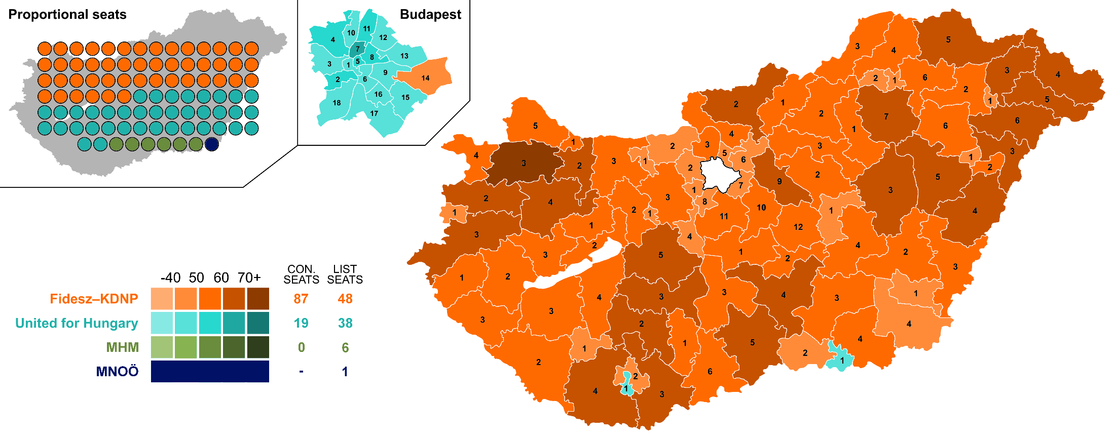
But a political triumph in the 2022 general election
By Erinthecute - File:2022_Hungarian_parliamentary_election_-_Template.svg, CC BY-SA
4.0, https://commons.wikimedia.org/w/index.php?curid=116648718
Notes:
Go back to the starred items

Slide 16
Case study I: local govt, Budapest 8th district
Old school local bureaucracy, inexperienced politicians: huge challenge
Some political centralization locally as well
Resources centralized away
Groundswell of local helpfulness
Quick reallocation of HR (e.g. school lunch replacement)
New channels of communication and interaction
Notes:
https://www.google.com/maps/place/Budapest,+J%C3%B3zsefv%C3%A1ros,+Hungary/@47.4893215,19.0839084,14z/data=!3m1!4b1!4m5!3m4!1s0x4741dcf3c3e0ae53:0x8913eb19db45353b!8m2!3d47.4894184!4d19.070668

Slide 17
Notes:
In a dozen languages, within days

Slide 18
Case study II: Who is hurt when schools are closed
Effort at distance learning online
But within a frontal, traditional system
That is unequal to start with
And with a very uneven distribution of digital resources and access
No reliable result info yet,
But outcome measures suggested a huge disparity in the success of remote teaching
And widespread mental and psycho-social costs
As well as learning outcomes

Slide 19
Possible further case studies
EU-Member State tensions
The organization of policy expertise input
Trade and travel vs pandemic security
The effects of no QUALY-based measura of Health Policy
cost-benefit decisions
The timing of measures
The role of social trust during COVID

Slide 20
What are the lessons?
COVID: a test of general resilience
„fog of war”
  urgent, non-routine measures
  hard, new trade-offs
  (Germany vs. Israel)
Politics can trump policy even in such adverse circumstances in a hybrid regime
  Communication is key
  EU membership no limitation in the short run

Slide 21
Selected Literature in English
Váradi: Policy responses to the coronavirus pandemic in Hungary during the first half of 2020 in The Hungarian Labour Market 2020
Elek, Mayer & Váradi: Impact of the Covid-19 pandemic on mortality and on the health care system in The Hungarian Labour Market 2021
Elek & al.: Effects of lower screening activity during the COVID-19 pandemic on breast cancer patient pathways: Evidence from the age cut-off of organized screening, Health Policy 2022
Elek & al.: Heterogeneous impact of the COVID-19 pandemic on lung, colorectal and breast cancer incidence in Hungary: results from time series and panel data models, BMJ Open 2022

Slide 22
Thank you for your attention!
  balazs.varadi@budapestinstitute.eu

